Slide 1
Brownfield Advisory Committee Meeting #1
February 24, 2021
City of East Point FY2019 EPA Community-wide Brownfield Assessment Grant

Slide 2
Introductions & Meeting Summary
Introductions & Meeting Summary
EPA’s Brownfield Program
East Point’s Brownfield Program
Brownfield Advisory Committee Wants, Needs, & Action Items
Open Discussion/Thank You

Slide 3
II. EPA’s Brownfield Program

Slide 4

Brownfields Defined
“…A Brownfield site is defined as real property, the expansion, redevelopment, or reuse of which may be complicated by the presence or potential presence of hazardous substances, pollutants, contaminants, controlled substances, petroleum or petroleum products, or is mine-scarred land.”

Slide 5
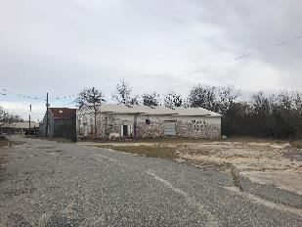
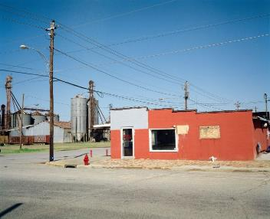
Objectives of Brownfields Redevelopment
  Return Abandoned Underutilized Sites to Productive Reuse
  Public Benefit
    Generate Tax Revenues
    Create Jobs
    Combat Sprawl
    Revitalize Blighted Areas
    Address Environmental Justice Issues
  “Recycle” Commercial and Industrial Properties
  Ties into Sustainability
  From Blight to Right

Slide 6


III. EPA’s Brownfield Program
Assessment Grants &
Multipurpose Grants
Cleanup Grants
Revolving Loan Grants
EPA
State Response Program
Job Training Grants
Small Technical Assistance Grants

Slide 7
III. East Point’s Brownfield Program

Slide 8
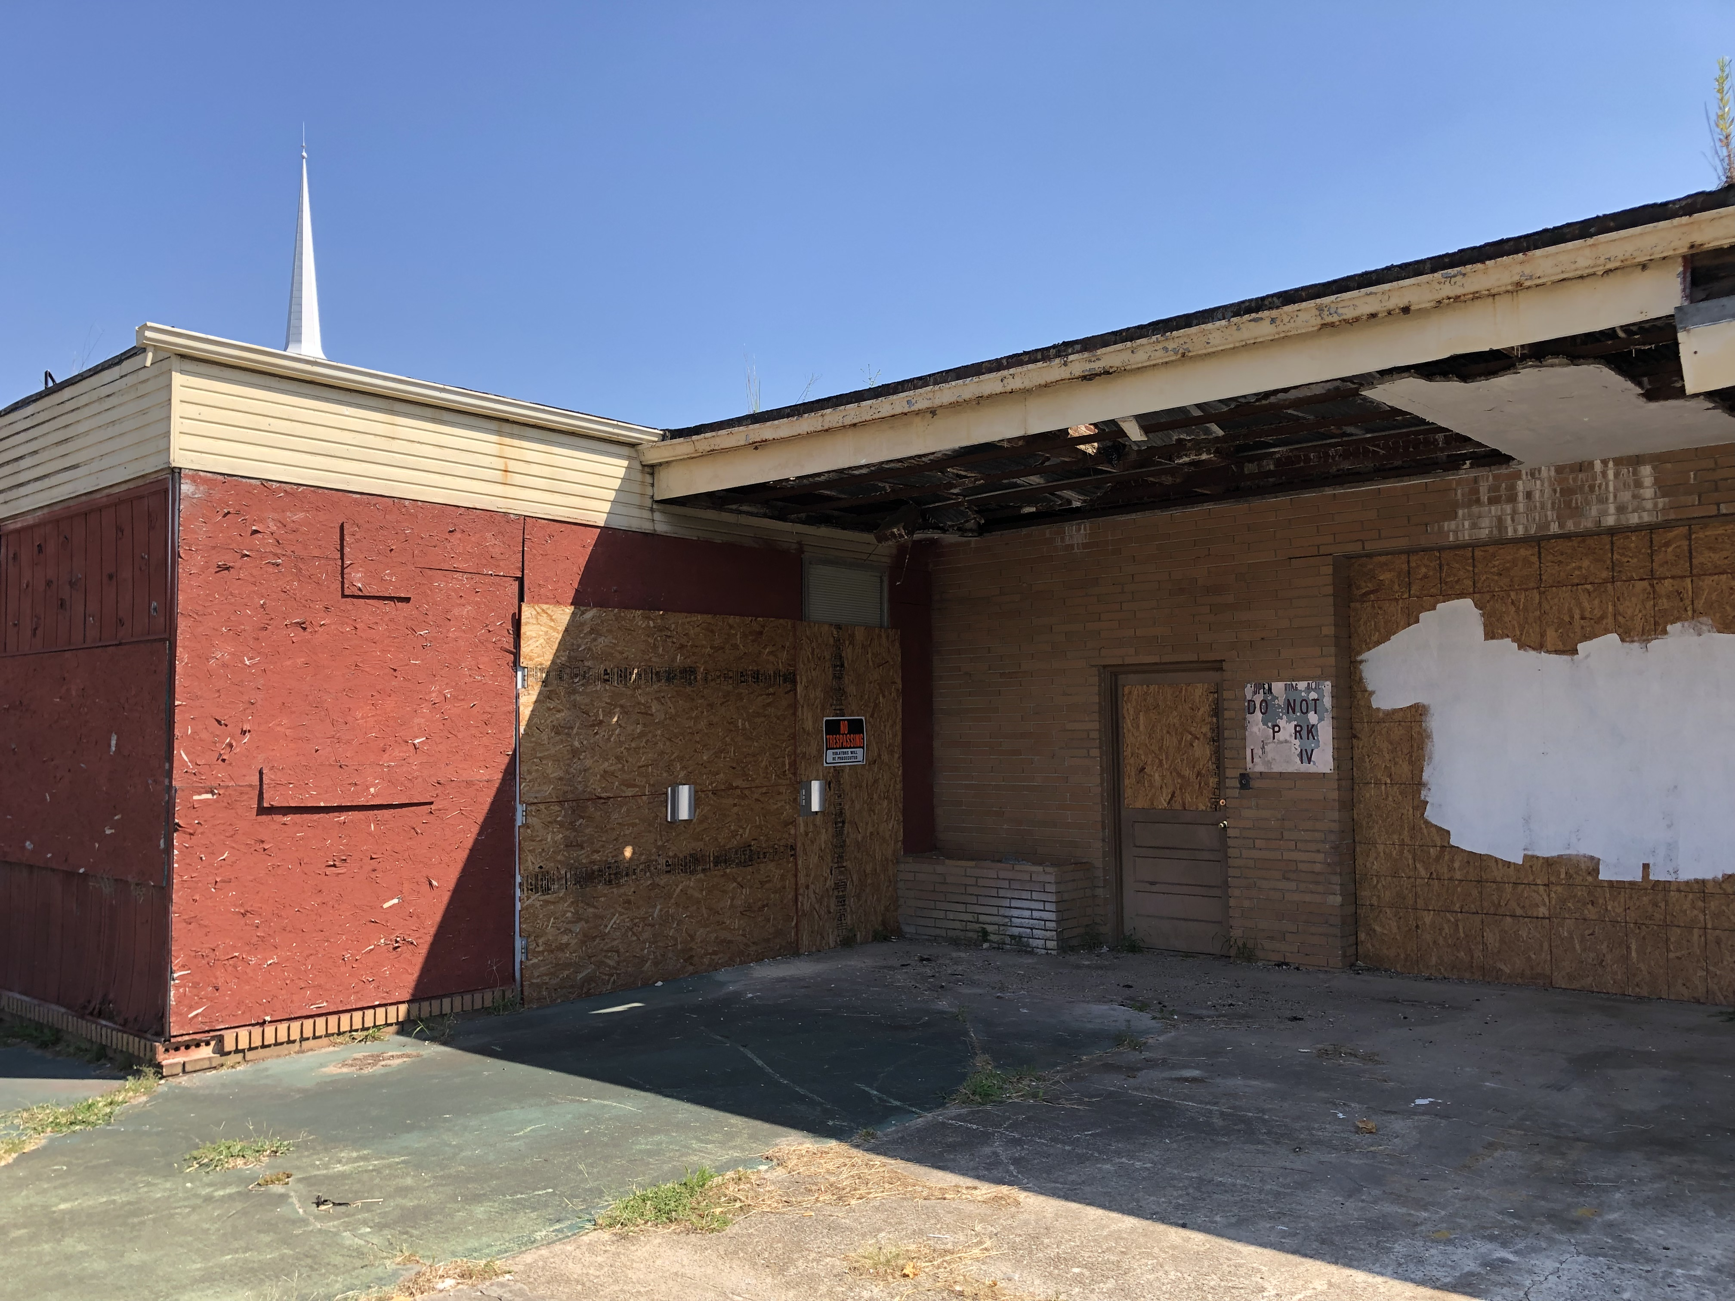
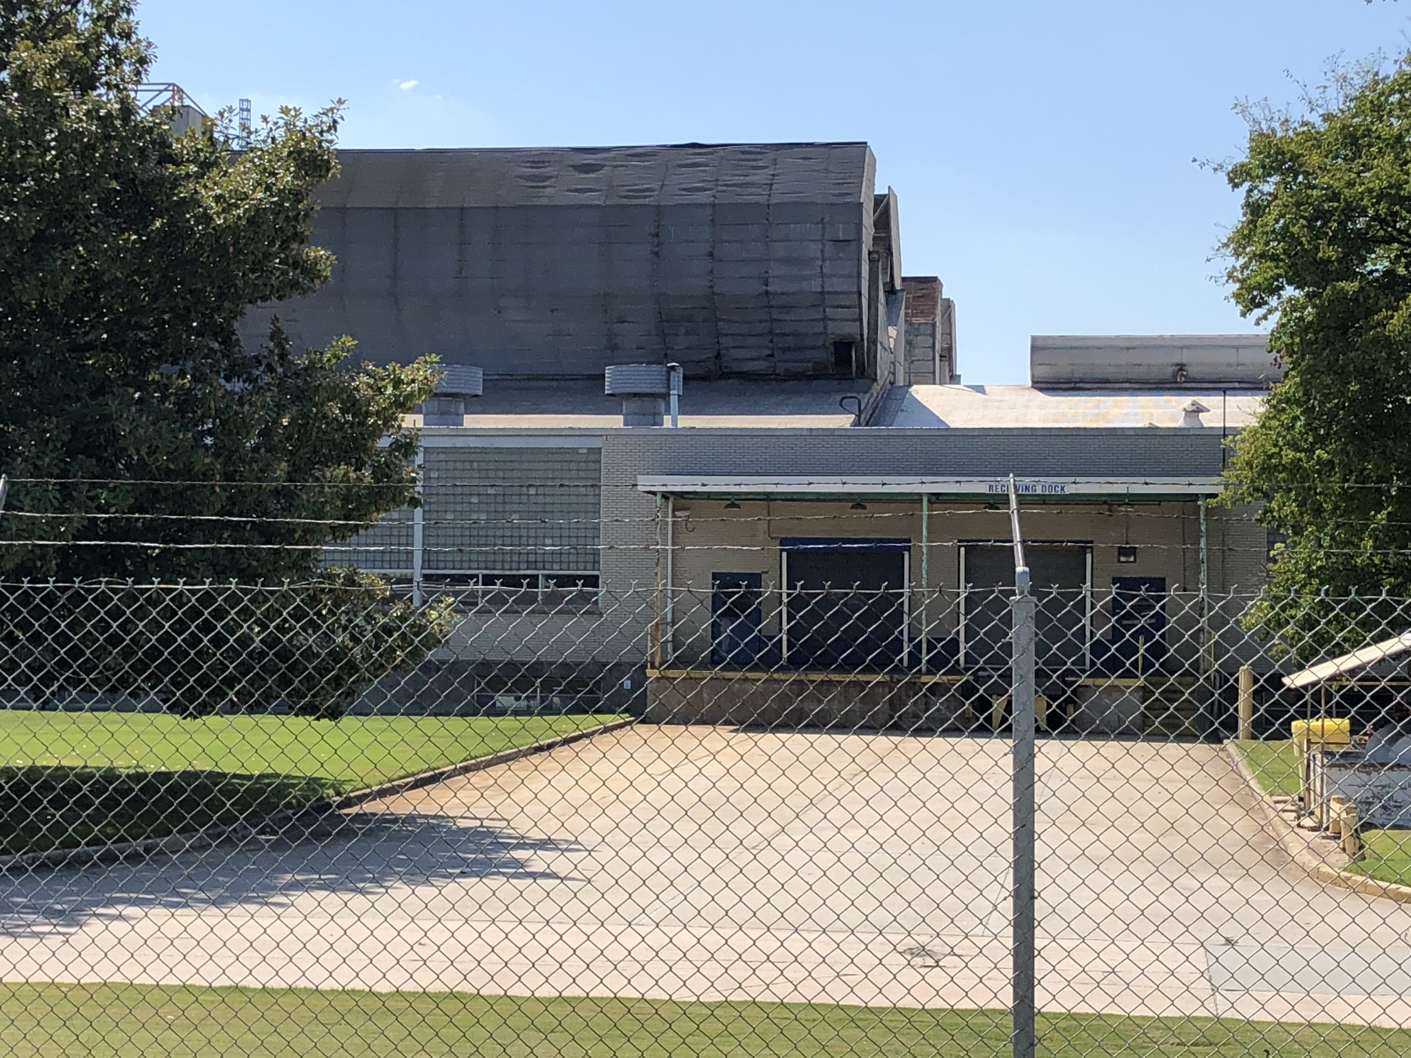
Brownfield Background
No previous municipal experience in EPA Brownfield program or grant awards
Applied for EPA’s Community-Wide Assessment Grant three times since 2016 prior to being awarded in 2019
Built partnerships with local nonprofits, community organizations, neighborhood associations

Slide 9
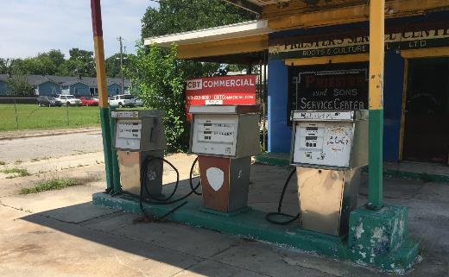
East Point’s Brownfield Program Goal
Build a Brownfield program that: focuses on social equity, improves access to needed amenities and promotes residents staying in place

Slide 10
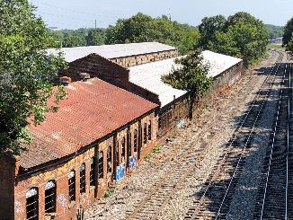
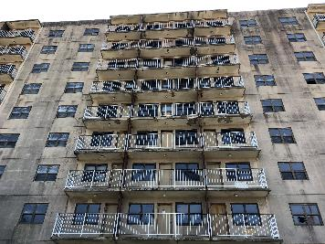
Target Areas
Target areas:
  Jefferson Park Neighborhood
  River Park Neighborhood
  Downtown
Target properties
  Atlanta Utility Works (AUW)
  Former General Chemical (GC)
  Owens Illinois Plant

Slide 11
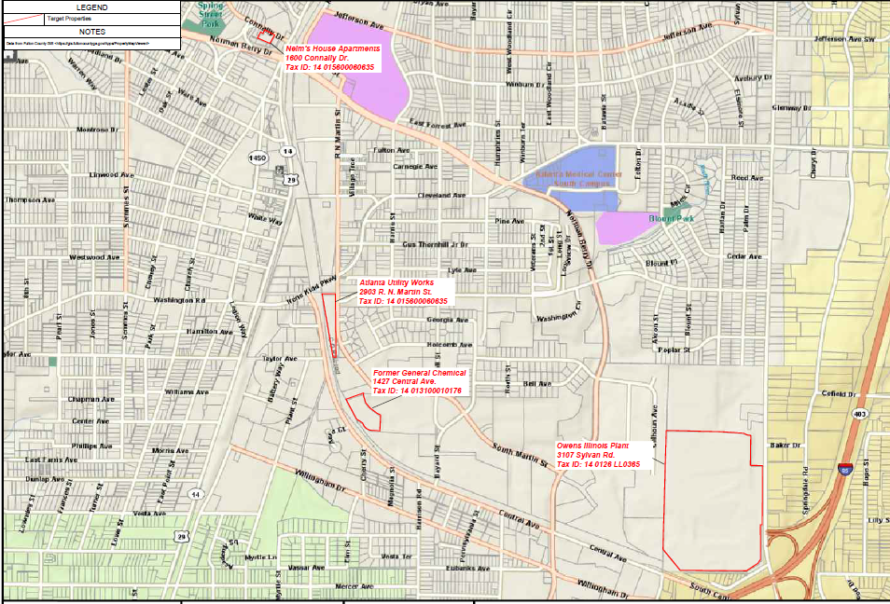
Target Site Map

Slide 12
An East Point Leveraged Vision
FY2022 Assessment Grant: $300,000
FY2022 Cleanup Grant: $500,000
FY2022 Job Training Grant: $200,000
FY2019 Assessment Grant: $300,000
FY2023 Revolving Loan Funding Grant: ~$1 million
One Brownfield Assessment Dollar Leverages $16.11*:
Therefore ~$2.3 million in Brownfield Grant Funds could yield >$37 Million in Private Investment
*https://www.epa.gov/brownfields/brownfields-program-accomplishments-and-benefits

Slide 13
Long-term Intent
Develop a program over the next 5-10 years, strategically applying for Brownfield grants that will:
Identify & assess contaminated properties
Enhance community engagement
Improve community health
Clean up environmental contamination
Reduce the number of blighted properties
Increase local economic redevelopment

Slide 14
IV. East Point’s Assessment Project Status

Slide 15
Community Engagement
  Community Engagement Plan
  Community Engagement Meeting #1 – June 15, 2020
    Virtual Meeting
    Over 18 members of the community
  Creation of a Brownfield Advisory Committee
    First meeting earlier today, Feb. 24, 2021
  Continue outreach to community to identify Brownfield sites

Slide 16
Site Assessment
  Developed Generic Quality Assurance Project Plan (QAPP)
  Reviewed City’s Brownfield Inventory
  Completed two Phase I ESAs
    Atlanta Utility Works – former utility works facility
      Phase II ESA is currently underway
    East Points Commons – approximately 41 parcels in downtown East Point
      Phase II ESA Scope of Work being developed
  Continue to identify Brownfield sites

Slide 17
IV. Brownfield Advisory Committee Wants, Needs, & Action Items

Slide 18

IV. Brownfield Advisory Committee Wants, Needs, & Action Items
  Who/What Sectors Should Participate on the Brownfield Advisory Committee?
  Outreach Methods Suggestions
  Site Nomination for Assessment/Cleanup
  Community Reuse/Development needs
  Other Suggestions/Concerns
  Action Items

Slide 19

Thank you!
Questions/Comments?
Keith Ziobron, P.E.
Senior Principal
Cardno
keith.ziobron@cardno.com
678.787.9576
Maceo Rogers, CEcD
Project Director
City of East Point
jmrogers@eastpointcity.org
404.270.7217

