Slide 1
Community Engagement/ Information Meeting #2 February 24, 2021 City of East Point FY2019 EPA Community-wide Brownfield Assessment Grant

Slide 2
Introductions & Meeting Summary
Introductions & Meeting Summary
EPA’s Brownfield Program
East Point’s Brownfield Program
East Point’s Assessment Project Status
Georgia Brownfield Programs, Contacts & Opportunities
Community Input/Open Discussion
Thank You & Questions

Slide 3
II. EPA’s Brownfield Program

Slide 4
Brownfields Defined
“…A Brownfield site is defined as real property, the expansion, redevelopment, or reuse of which may be complicated by the presence or potential presence of hazardous substances, pollutants, contaminants, controlled substances, petroleum or petroleum products, or is mine-scarred land.”

Slide 5
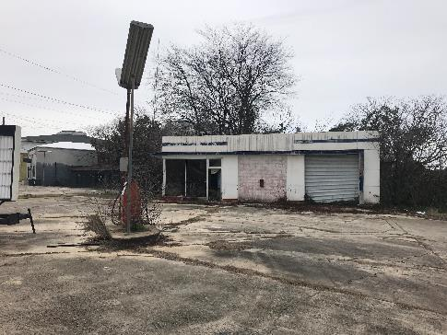
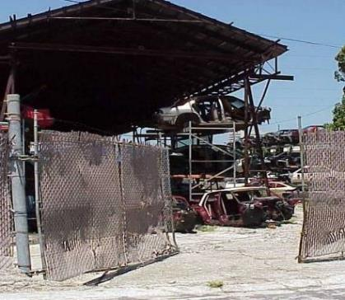
Brownfields Include
Former Gas Stations - Auto Repair
Junkyards

Slide 6
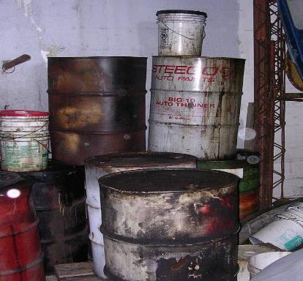
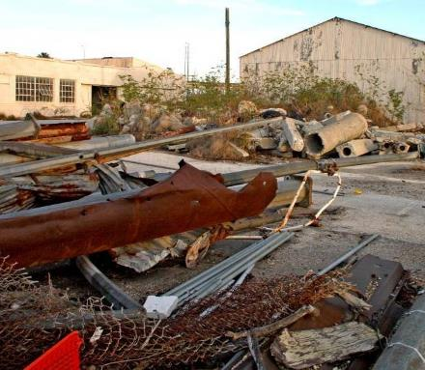
Brownfields Include
Orphan Hazardous Sites
Former Industrial Properties

Slide 7
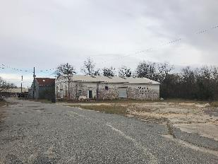
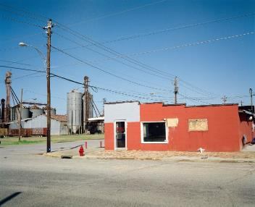
Objectives of Brownfields Redevelopment
Return Abandoned Underutilized Sites to Productive Reuse
Public Benefit
Generate Tax Revenues
Create Jobs
Combat Sprawl
Revitalize Blighted Areas
Address Environmental Justice Issues
“Recycle” Commercial and Industrial Properties
Ties into Sustainability
From Blight to Right

Slide 8
III. EPA’s Brownfield Program
Assessment Grants &
Multipurpose Grants
Cleanup Grants
Revolving Loan Grants
EPA
State Response Program
Job Training Grants
Small Technical Assistance Grants

Slide 9
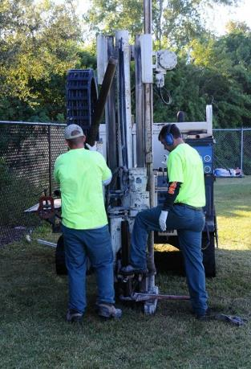
EPA Assessment Grants
$300,000 EPA Brownfields Community-wide Assessment Grant
Funded Activities Include :
Brownfields Inventory – focus on developable sites
Community Outreach and Engagement – Paramount to Brownfields Success
Phase I Environmental Assessments –
Petroleum Sites – Gas Stations & Tank Removals
Hazardous Substances – Solvents, Metals, Asbestos
Petroleum Sites/Hazardous Materials Sites
Remove & Quantify Environmental Stigma
Phase II Environmental Assessments
Presence or Absence of Contamination
Cleanup and Reuse Planning

Slide 10
EPA Contact for East Point Brownfield Coalition Assessment
East Point’s United States Environmental Protection Agency Region IV Project Officer
Sara Janovitz, Physical Scientist
US Environmental Protection Agency - Region 4
LCR Division - Brownfields Section
10th Floor; 61 Forsyth St. SW; Atlanta, GA 30303
Phone: (404) 562.8970
Email: janovitz.sara@epa.gov

Slide 11
III. East Point’s Brownfield Program

Slide 12
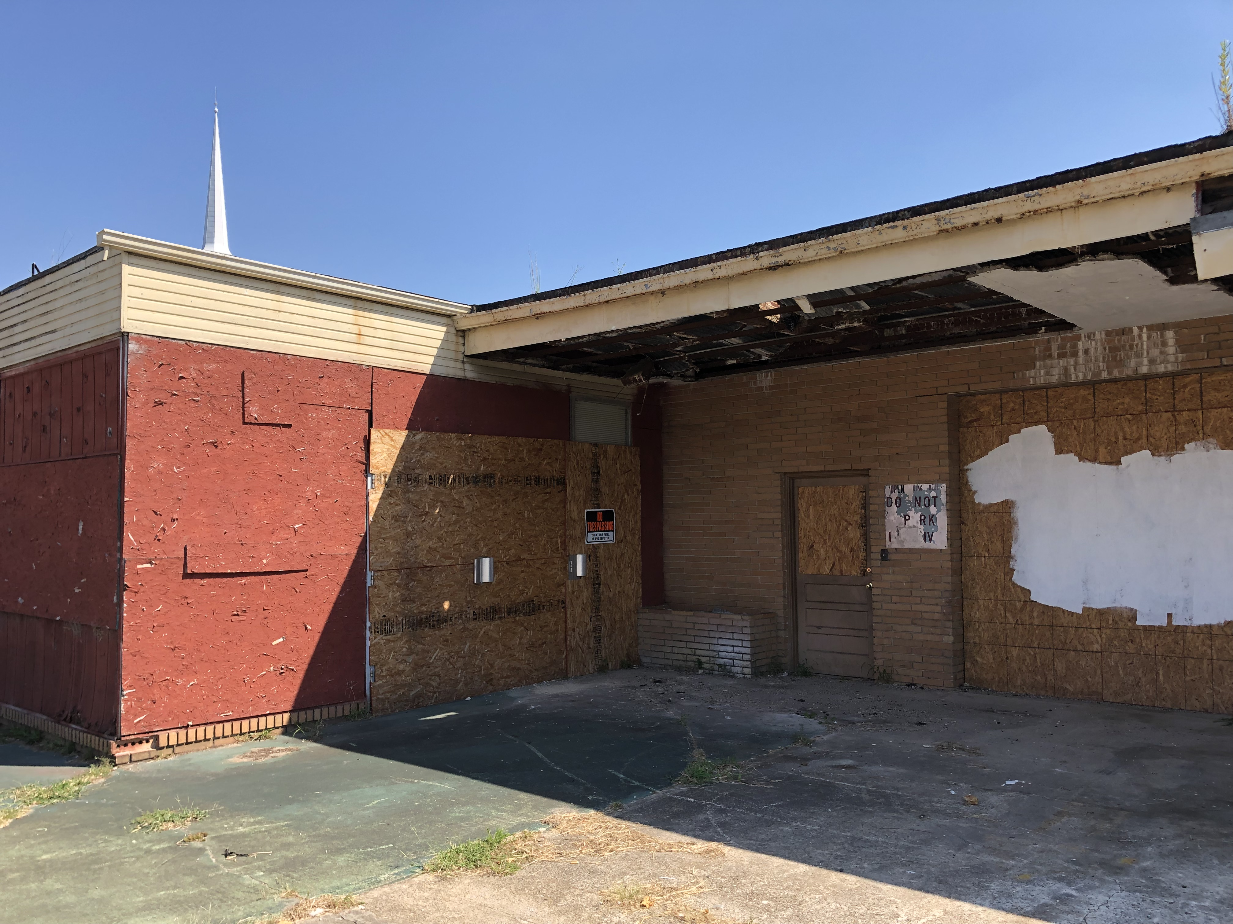
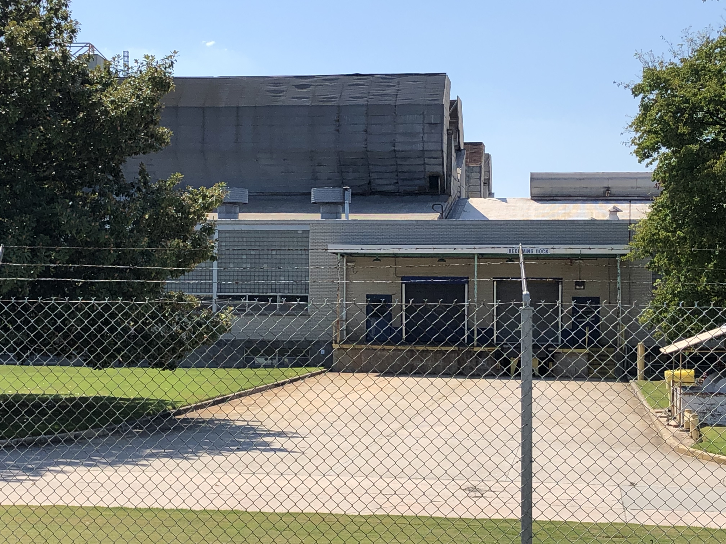
Brownfield Background
No previous municipal experience in EPA Brownfield program or grant awards
Applied for EPA’s Community-Wide Assessment Grant three times since 2016 prior to being awarded in 2019
Built partnerships with local nonprofits, community organizations, neighborhood associations

Slide 13
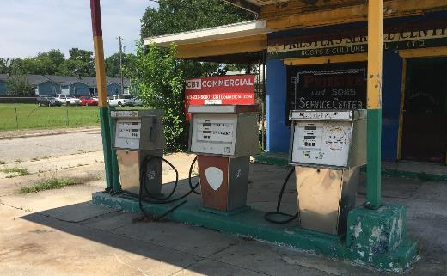
East Point’s Brownfield Program Goal
Build a Brownfield program that: focuses on social equity, improves access to needed amenities and promotes residents staying in place

Slide 14
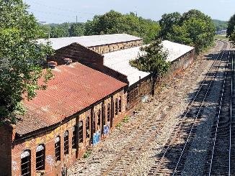
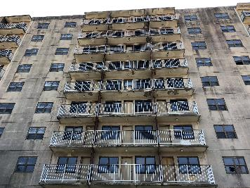
Target Areas
Target areas:
Jefferson Park Neighborhood
River Park Neighborhood
Downtown
Target properties
Atlanta Utility Works (AUW)
Former General Chemical (GC)
Owens Illinois Plant

Slide 15
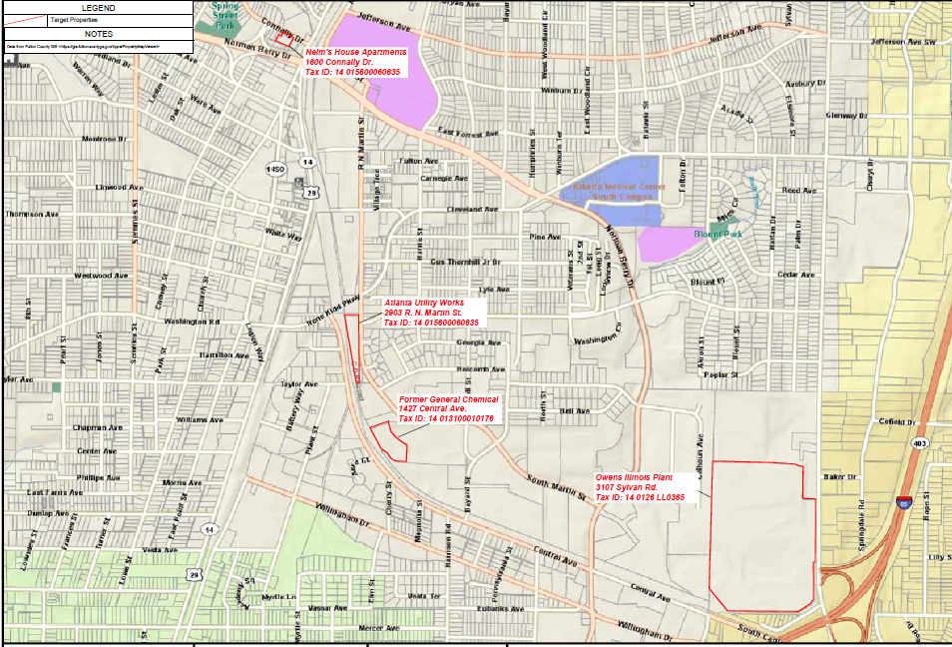
Target Site Map

Slide 16
An East Point Leveraged Vision
FY2022 Assessment Grant: $300,000
FY2022 Cleanup Grant: $500,000
FY2022 Job Training Grant: $200,000
FY2019 Assessment Grant: $300,000
FY2023 Revolving Loan Funding Grant: ~$1 million
One Brownfield Assessment Dollar Leverages $16.11*:
Therefore ~$2.3 million in Brownfield Grant Funds could yield >$37 Million in Private Investment
*https://www.epa.gov/brownfields/brownfields-program-accomplishments-and-benefits

Slide 17
Long-term Intent
Develop a program over the next 5-10 years, strategically applying for Brownfield grants that will:
Identify & assess contaminated properties
Enhance community engagement
Improve community health
Clean up environmental contamination
Reduce the number of blighted properties
Increase local economic redevelopment

Slide 18
IV. East Point’s Assessment Project Status

Slide 19
Community Engagement
Community Engagement Plan
Community Engagement Meeting #1 – June 15, 2020
Virtual Meeting
Over 18 members of the community
Creation of a Brownfield Advisory Committee
First meeting earlier today, Feb. 24, 2021
Continue outreach to community to identify Brownfield sites

Slide 20
Site Assessment
Developed Generic Quality Assurance Project Plan (QAPP)
Reviewed City’s Brownfield Inventory
Completed two Phase I ESAs
Atlanta Utility Works – former utility works facility
Phase II ESA is currently underway
East Points Commons – approximately 41 parcels in downtown East Point
Phase II ESA Scope of Work being developed
Continue outreach to identify Brownfield sites

Slide 21
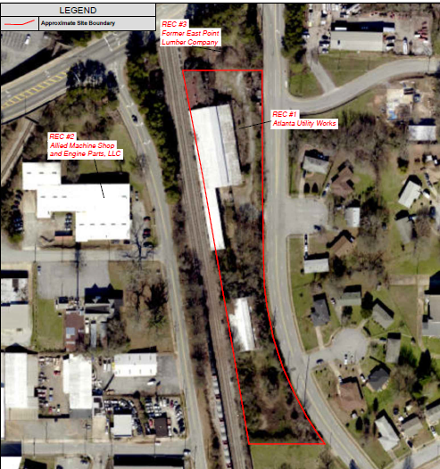
Atlanta Utility Works
Four parcels totaling 2.3 acres, currently vacant industrial property
Historically supporting Atlanta Utility Works and manufacturer since the 1880s
Numerous historical environmental concerns
Industrial machinery production
Supported gasoline tanks
Coal yard
Metal foundry
Phase II ESA to assess these issues is underway

Slide 22
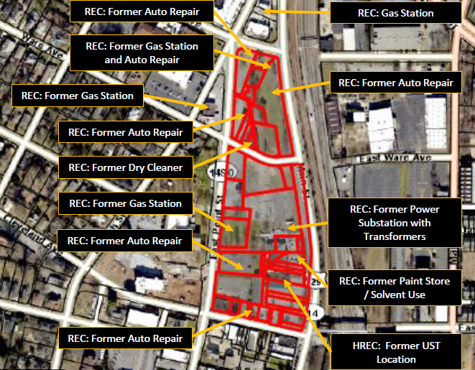
East Point Commons
41 parcels totaling 9.6 acres
Mostly vacant, with library and health center
Historically commercial since the 1900s
Numerous historical environmental concerns
Gas stations and auto repair facilities
Dry cleaners
Industrial operations and Georgia Power substation
Phase II ESA scope of work is currently being developed

Slide 23
V. Georgia Brownfield Programs, Contacts & Opportunities

Slide 24
Georgia’s Brownfields Program
Shannon D. Ridley
Brownfield Coordinator - Response and Remediation Program-Brownfield
2 Martin Luther King Jr.
Suite 1054
Atlanta, GA 30334
Shannon.Ridley@dnr.ga.gov
404-657-8616
Benefits
Limitation of Liability
Brownfield Tax Abatement
Exemption from the need to address dissolved phase ground water contamination
Qualified Participant not responsible to address associated off-site contamination

Slide 25
VI. Community Input/Open Discussion

Slide 26
Community Input/Open Discussion
Identify/Suggest Additional Sites for Assessment
Discuss Community Reuse/Development needs
Other Suggestions/Concerns

Slide 27
Thank you!
Questions/Comments?
Keith Ziobron, P.E.
Senior Principal
Cardno
keith.ziobron@cardno.com
678.787.9576
Maceo Rogers, CEcD
Project Director
City of East Point
jmrogers@eastpointcity.org
404.270.7217

