Slide 1
Community Engagement/Information Meeting 1
July 15, 2020
City of East Point FY2019 EPA Community-wide Brownfield Assessment Grant

Slide 2
Introductions & Meeting Summary
Introductions & Meeting Summary
EPA’s Brownfield Program
East Point’s Brownfield Program – How Did we get here and where are we going?
East Point’s Assessment Project Scope & Status
Georgia Brownfield Programs, Contacts & Opportunities
Community Input/Open Discussion
Thank You & Questions

Slide 3
II. EPA’s Brownfield Program

Slide 4

Brownfields Defined
“…A Brownfield site is defined as real property, the expansion, redevelopment, or reuse of which may be complicated by the presence or potential presence of hazardous substances, pollutants, contaminants, controlled substances, petroleum or petroleum products, or is mine-scarred land.”

Slide 5
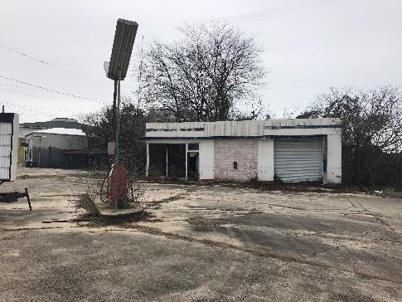
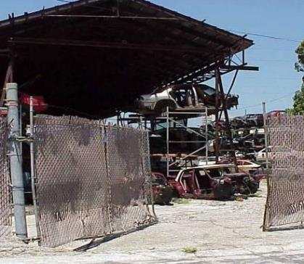
Brownfields Include
Former Gas Stations - Auto Repair
Junkyards

Slide 6
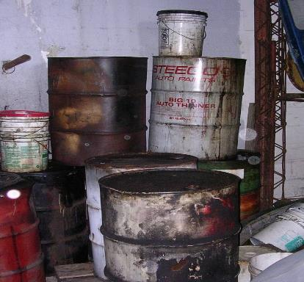
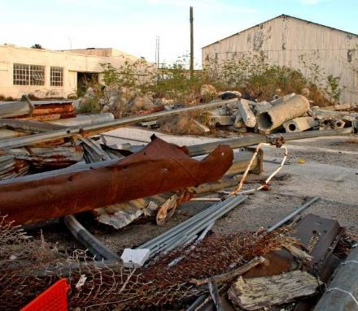
Brownfields Include
Orphan Hazardous Sites
Former Industrial Properties

Slide 7
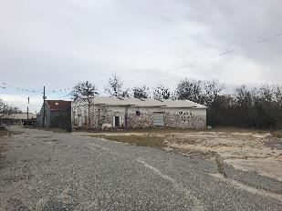
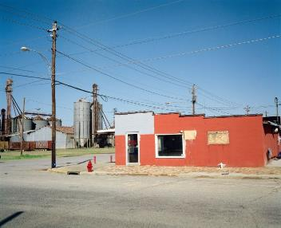
Objectives of Brownfields Redevelopment
  Return Abandoned Underutilized Sites to Productive Reuse
  Public Benefit
    Generate Tax Revenues
    Create Jobs
    Combat Sprawl
    Revitalize Blighted Areas
    Address Environmental Justice Issues
  “Recycle” Commercial and Industrial Properties
  Ties into Sustainability
  From Blight to Right

Slide 8
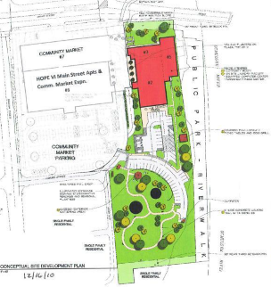
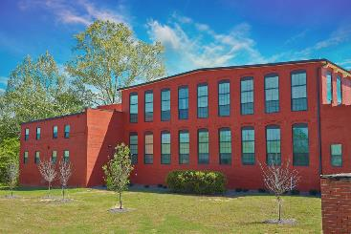
Insights Into the Brownfields Process
  Supports Economic Development
  Brownfield Projects are Simply Real Estate Transactions With an Environmental Twist
  Banks/Lending institutions require some level of Site Assessment/Due Diligence
  Site Does Not Need to be Contaminated to be a Brownfield – “Perception is Reality”

Slide 9

III. EPA’s Brownfield Program
Assessment Grants &
Multipurpose Grants
Cleanup Grants
Revolving Loan Grants
EPA
State Response Program
Job Training Grants
Small Technical Assistance Grants

Slide 10

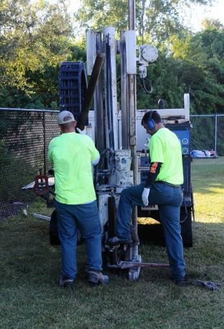
EPA Assessment Grants
$300,000 EPA Brownfields Community-wide Assessment Grant
Funded Activities Include :
  Brownfields Inventory – focus on developable sites
  Community Outreach and Engagement – Paramount to Brownfields Success
  Phase I Environmental Assessments –
    Petroleum Sites – Gas Stations & Tank Removals
    Hazardous Substances – Solvents, Metals, Asbestos
    Petroleum Sites/Hazardous Materials Sites
    Remove & Quantify Environmental Stigma
  Phase II Environmental Assessments
    Presence or Absence of Contamination

Slide 11
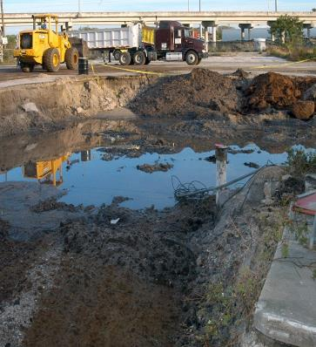
Other EPA Grant Opportunities - Clean Up Grants
EPA Brownfields Clean-up Grant
(Grantee may apply for 3 Cleanup Grants)
  Up to $500,000 per site
  Local governments or non-profits (match TBD)
  Non Profits Are Eligible
Brownfields Clean-up Revolving Loan Grants
  Up to $1 million for clean-up
  50% sub-grants for non-profits for clean-up
  Low-to-no-interest loans for public and private sector
  Potential for Supplemental funds to be granted each year
The US Conference of Mayors has identified lack of Clean-up Funding as the # 1 Impediment to Brownfields Redevelopment

Slide 12

EPA Contact for East Point Brownfield Coalition Assessment
  East Point’s United States Environmental Protection Agency Region IV Project Officer
Sara Janovitz, Physical Scientist
US Environmental Protection Agency - Region 4
LCR Division - Brownfields Section
10th Floor; 61 Forsyth St. SW; Atlanta, GA 30303
Phone: (404) 562.8574
Email: janovitz.sara@epa.gov

Slide 13
III. East Point’s Brownfield Program – How Did we get here and where are we going?

Slide 14
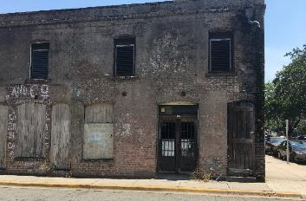
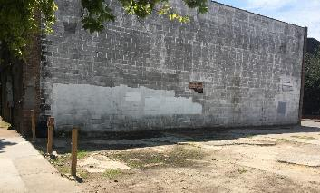
Brownfield Background
No previous municipal experience in EPA Brownfield program or grant awards
Applied for EPA’s Community-Wide Assessment Grant three times since 2015 prior to being awarded in 2018
Built partnerships with local nonprofits, community organizations, neighborhood associations

Slide 15
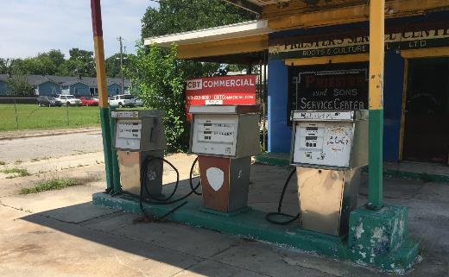
East Point’s Brownfield Program Goal
Build a Brownfield program that: focuses on social equity, improves access to needed amenities and promotes residents staying in place

Slide 16
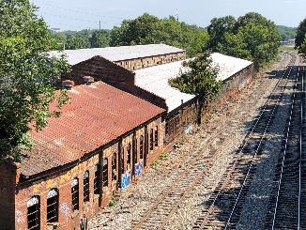
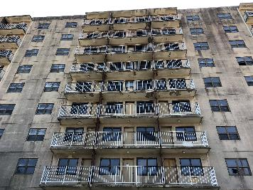
Target Areas
Target areas:
  Jefferson Park Neighborhood
  River Park Neighborhood
  Downtown
Target properties
  Atlanta Utility Works (AUW)
  Former General Chemical (GC)
  Owens Illinois Plant

Slide 17
An East Point Leveraged Vision
FY2022 Assessment Grant: $300,000
FY2022 Cleanup Grant: $500,000
FY2022 Job Training Grant: $200,000
FY2019 Assessment Grant: $300,000
FY2023 Revolving Loan Funding Grant: ~$1 million
One Brownfield Assessment Dollar Leverages $16.11*:
Therefore ~$2.3 million in Brownfield Grant Funds could yield >$37 Million in Private Investment
*https://www.epa.gov/brownfields/brownfields-program-accomplishments-and-benefits

Slide 18
Long-term Intent
Develop a program over the next 5-10 years, strategically applying for Brownfield grants that will:
Identify & assess contaminated properties
Enhance community engagement
Improve community health
Clean up environmental contamination
Reduce the number of blighted properties
Increase local economic redevelopment

Slide 19
IV. East Point’s Assessment Project Scope & Status

Slide 20
City of East Point Contact Information
Maceo Rogers
Project Director
jmrogers@eastpointcity.org
Lolita Grant
Finance Director
lgrant@eastpointcity.org
Regina Carter
Economic Development Specialist
rcarter@eastpointcity.org

Slide 21
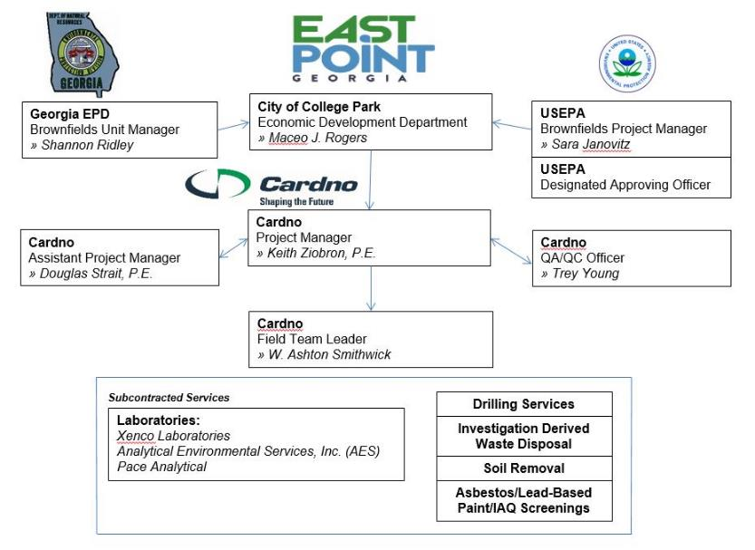
Organization Chart

Slide 22
Task 1 - Project Management & Reporting
Financial Accounting
Monthly status reports (emails)
Regular entry of site information into the EPA Assessment, Cleanup and Redevelopment Exchange System (ACRES)
Quarterly Reports (10 assumed)
Annual Reports (2 assumed)
Property Profile Forms for each site assessed (10 assumed)
MBE/WBE Reports (2 assumed)
Close-Out Report (1 assumed)
Coordination with EPA & GA EPD

Slide 23
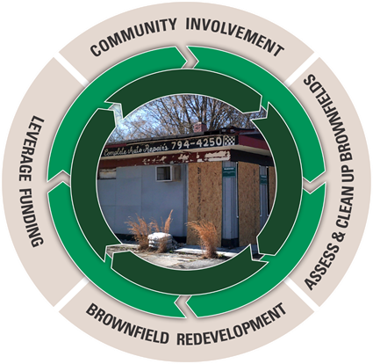
Task 2 – Community Engagement/Involvement
Assist East Point in the establishment of local Brownfields Advisory Board (BAB);
Attend and facilitate meetings with the BAB
Hold 1- 2 Brownfield Program Public Involvement meetings per year;
Develop/maintain strategic partnerships;
Disseminate information/comments to/from community & stakeholders; and
Host meetings with applicants/property owners interested in leveraging the assessment dollars.

Slide 24
Task 3 – Site Identification & Assessment
Site Inventory (Dry cleaners, Gas Stations…)
Up to 10 ASTM-AAI compliant Phase I ESAs
1 Generic Quality Assurance Project Plan
~5 Site-Specific Quality Assurance Project Plans
~5 Phase II Environmental Site Assessments

Slide 25
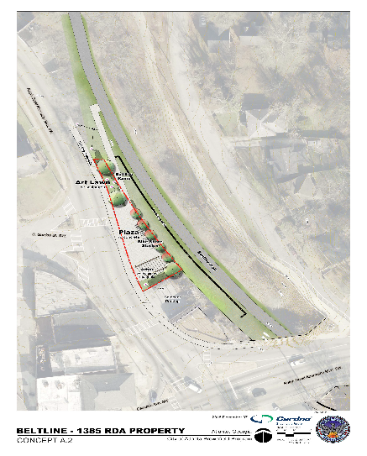
Task 4 – Cleanup and Development Planning
Up to 4 Analysis of Brownfields Cleanup Alternatives (ABCAs)
Concept Level Reuse Planning
Site Marketing Materials

Slide 26
Work Completed To Date & Net Steps
  Generic Quality Assurance Project Plan Final
  Kick-off with EPA Project Officer
  Public Involvement Plan Final
  E. Gwinnett Street/Arena District Phase I & II ESA
  Select Additional Sites for Assessment and Complete Assessment Work
  Develop Cleanup and Reuse Plans for Sites with Redevelopment Potential

Slide 27
Schedule/Mileposts
Grant Closeout: September 30, 2022
Site Selection Period: On-going through early 2020
Phase I ESAS: On-going through early 2020
Community Engagement
  Meeting 1: July 15, 2020
  Meeting 2: October/November 2020
  Meeting 3: April/May 2021
  Meeting 4: October/November 2021
  Meeting 5: April 2022 (grant application planning)
Phase II ESAs: July 2020 through early 2021
ABCAs/Reuse Planning: September 2020 through early 2020
Closeout Report: August 2022

Slide 28
V. Georgia Brownfield Programs, Contacts & Opportunities

Slide 29

Georgia’s Brownfields Program
Shannon D. Ridley
Brownfield Coordinator - Response and Remediation Program-Brownfield
2 Martin Luther King Jr.
Suite 1054
Atlanta, GA 30334
Shannon.Ridley@dnr.ga.gov
404-657-8616
Benefits
Limitation of Liability
Brownfield Tax Credits
Exemption from the need to address dissolved phase ground water contamination
Qualified Participant not responsible to address associated off-site contamination

Slide 30
VI. Community Input/Open Discussion

Slide 31

Community Input/Open Discussion
  Identify/Suggest Additional Sites for Assessment
  Discuss Community Reuse/Development needs
  Other Suggestions/Concerns

Slide 32

Thank you!
Questions/Comments?
Keith Ziobron, P.E.
Senior Principal
Cardno
keith.ziobron@cardno.com
678.787.9576
Maceo Rogers
Project Director
City of East Point
jmrogers@eastpointcity.org
404.270.7217

