Slide 1

East Washington/River Park
Revitalization Plan Meeting
Angela Blatch, Senior Planner
Office of the City Manager – Neighborhood Planning
October 22, 2019

Slide 2
E. Washington Public Safety Incidents
October 16, 2018 – October 16, 2019

Slide 3
River Park Public Safety Incidents
October 16, 2018 – October 16, 2019

Slide 4
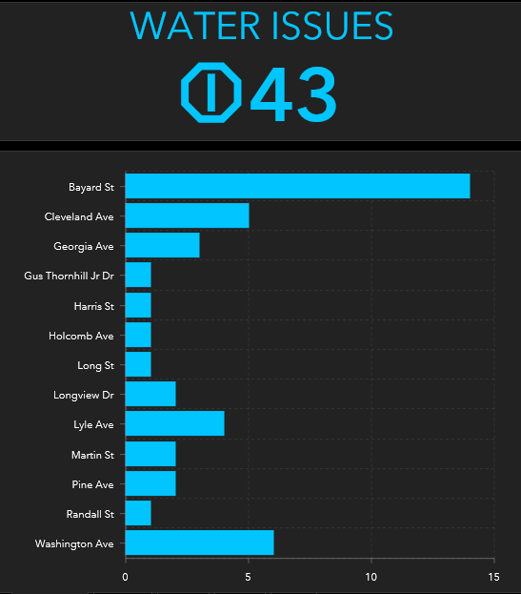

E. Washington Water & Sewer Issues
(2011 – present)
2” – 4” Water Main Replacement
Work In Progress:
  Blount Street
Remainder proposed to be replaced within the next two (2) fiscal years.

Slide 5
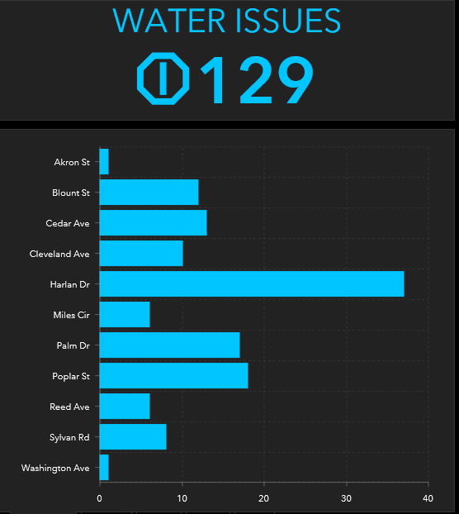
River Park Water & Sewer Issues
(2011 – present)
2” – 4” Water Main Replacement
Work In Progress:
  Blount Street
Remainder proposed to be replaced within the next two (2) fiscal years.

Slide 6
Neighborhood Roads
(conditions as of 2011)

Slide 7
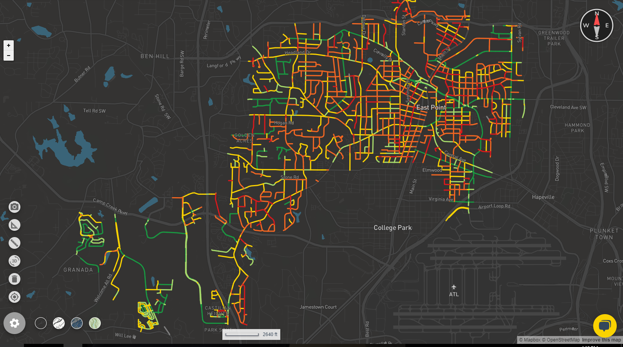
Before and after TSPLOST
Projects | Resurfaced (miles) | Sidewalks (miles)
Before TSPLOST (2014-2017) | 7.9 | 1.2
2017-2018 Projects | 6.6 | 3.3
FY20 Proposed Projects | 18.6 | 10.4
In the spring 2019, the Public Works Department procured a camera based pavement rating system. On a scale from 0-100, the current pavement rating was 49, compared to a 61 rating measured in the 2012 Pavement Study. A full Pavement Condition Index study is planned for spring 2020.
* The 2019 rating did not include current resurfacing project.

Slide 8
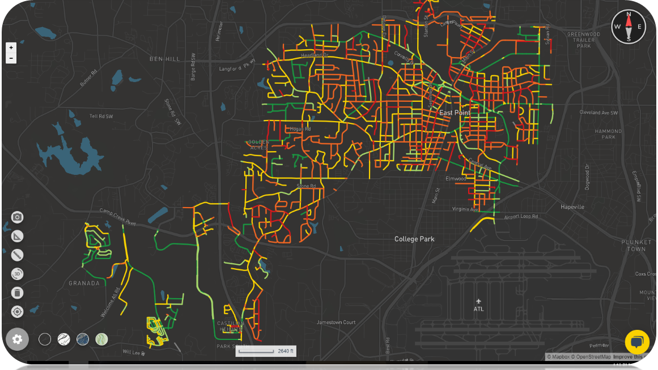

Slide 9
Neighborhood Sidewalks
(conditions as of 2013)

Slide 10
Addressing Sidewalk Issues
The Public Works Transportation Division will submit for solicitation in the Spring of 2020 or the Capital FY21 budget a plan to perform a comprehensive sidewalk evaluation. The proposed sidewalk evaluation will provide a rating of the sidewalk conditions within the R/W of the City of East Point, and the project will provide a resource to plan for sidewalk installation, replacement and repairs. Through the sidewalk evaluation provided to the Public Works Department, the Department will be able to create a sidewalk GIS map, plan projects, budgets and meet ADA compliance for the City.

Slide 11
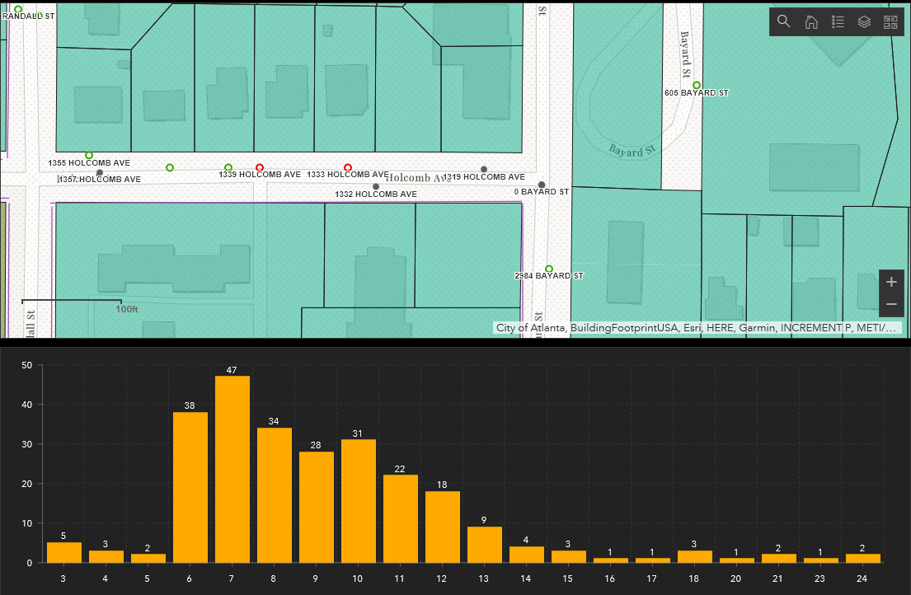

East Washington Housing Inventory

Slide 12
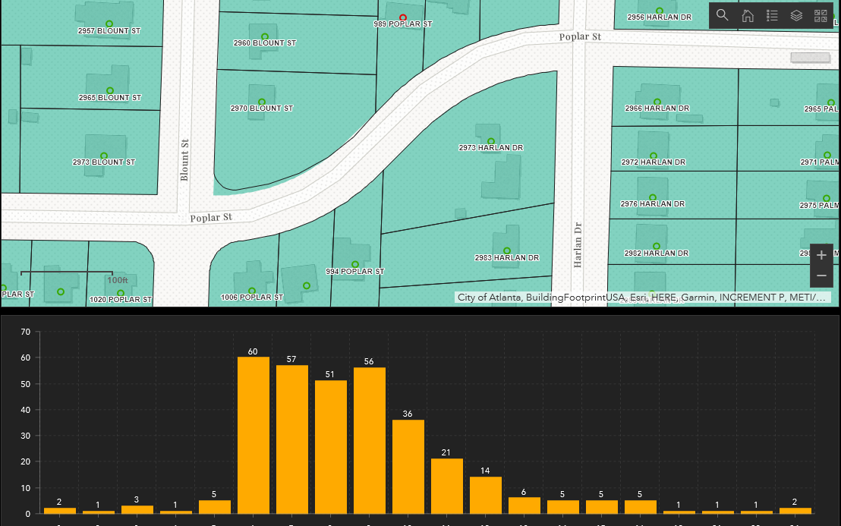

River Park Housing Inventory

Slide 13
Questions & Answers / Next Steps

