Slide 1
FY2019 Proposed Budget Open House
Presented by
Fred Gardiner, City Manager

Slide 2
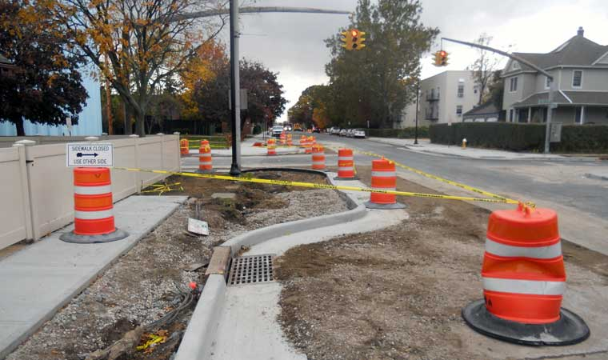
Framework of the FY19 Budget:
Investment in our Public Safety Officials (Police and Fire)
Continued Investment in the City’s Infrastructure, Facilities and Equipment
Implement the initiatives of Council
Improved Health care and Benefits for Employees and Retirees

Slide 3
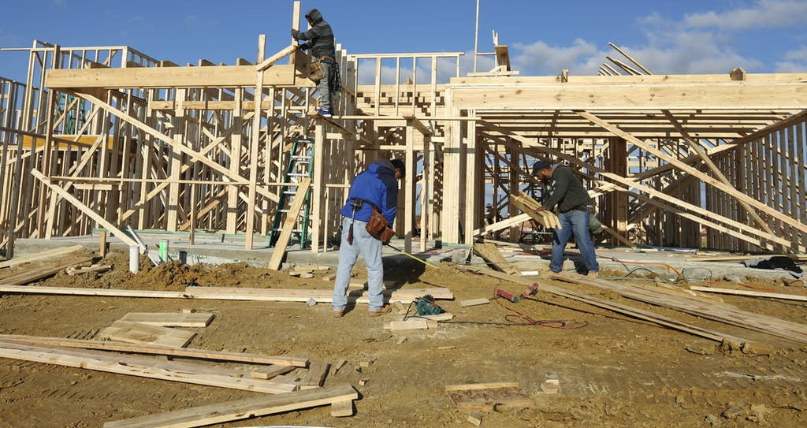
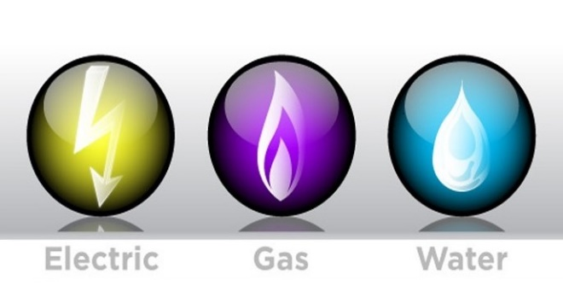
What’s NOT in the Budget??
NO Property Tax increases
NO Utility fee increases
NO Permit Fee increases

Slide 4
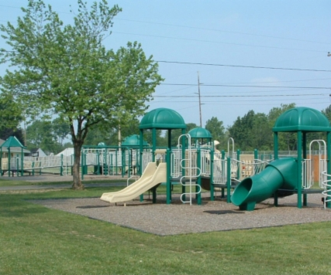
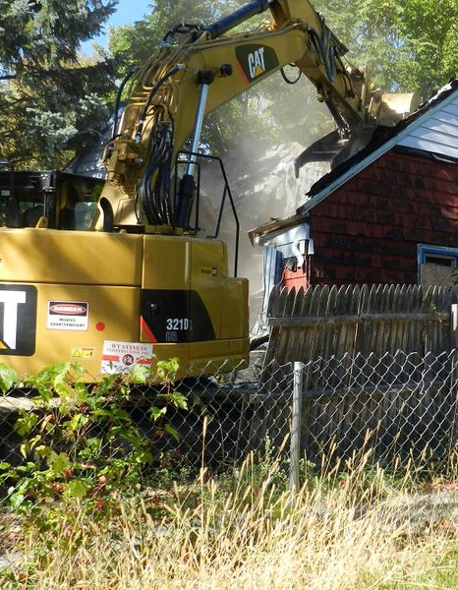
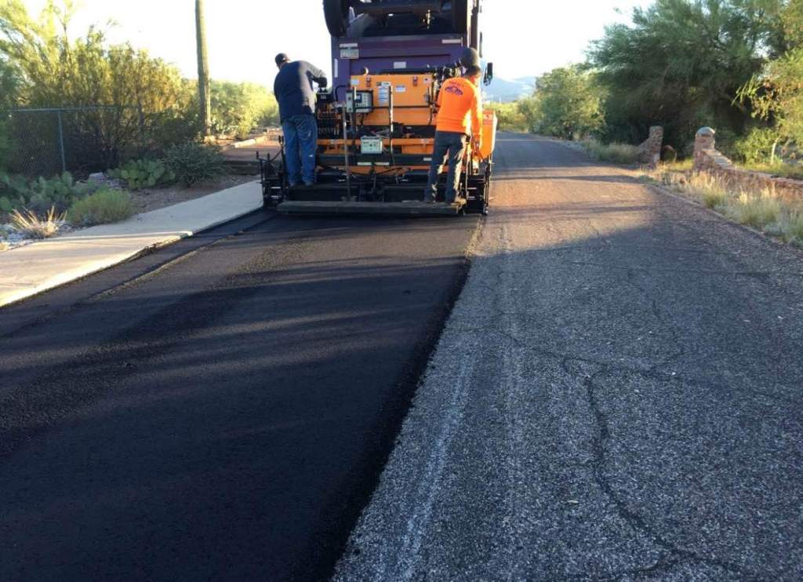
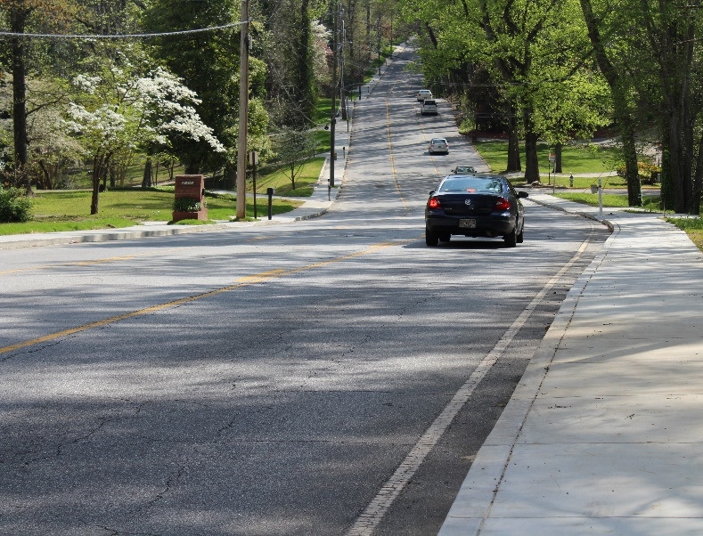
What’s in the Budget??
City Wide Budget Expenditures - $166.6M
Key Community Projects:
New Sidewalks and Improvement to existing
New roadway pavements and intersection improvements
Removal of Blight and Substandard Buildings
Improvements to existing parks and programs
Improved meter reading services
Improvements to electric grid that limit outages
New Streetscape in the historic downtown
Increase pay for public safety officials (Police/Fire)

Slide 5
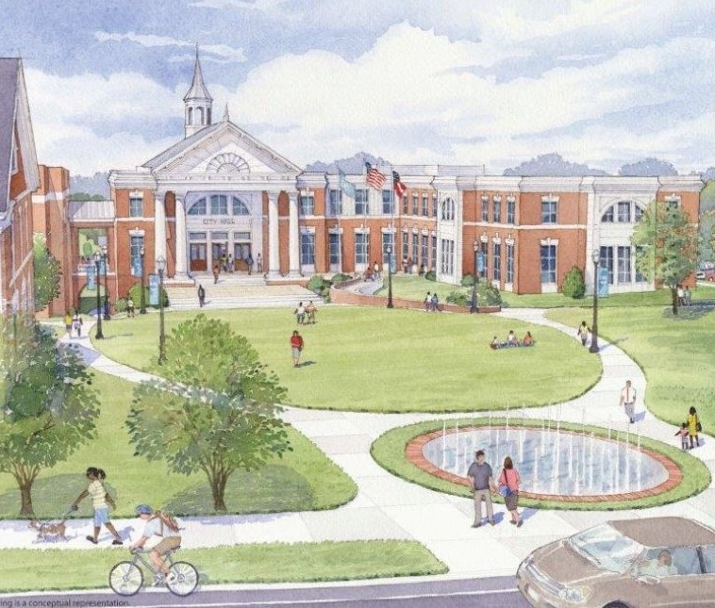
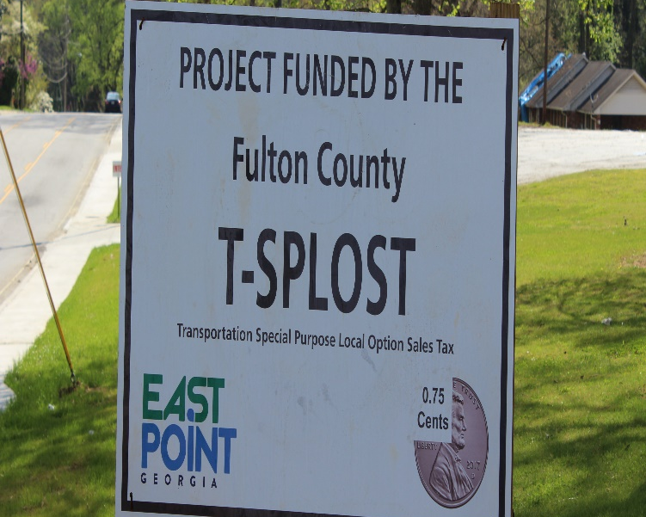
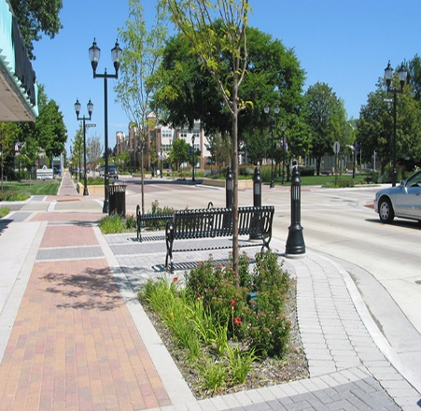
What’s in the Budget??
City Wide Budget - $170.3M Revenues
Key Projects:
TSPLOST $6,983,946
New City Hall $6,500,000
City Hall Auditorium $6,500,000
AMI $1,050,000
Streetscape/Road(LCI) $5,207,515
Streetscape/Road(TE) $2,500,000

Slide 6
Other City Budget Priorities
Completion of Ben Hill Fire and Training Station
Upgrading of City’s Infrastructure and Equipment
Cost of Living Adjustment (COLA) of (3%) percent for all Employees
New Livable Wage of $14.00 for East Point Employees.
Planning & Community Development Electronic Permitting System
Funding and Partnership for Blight Plan
Complete construction of a new City Hall Building
Completion of Enterprise Resources Planning (ERP) System

Slide 7
Proposed Revenue & Expenditures by Fund
Fund | Revenues | Expenditures | $Change
General Fund | 42,207,625 | 42,013,755 | 193,870
Confiscated Assets | 316,965 | 316,965 | -
E911 | 1,576,020 | 1,576,020 | -
Restricted Funds | 12,477,974 | 12,477,974 | -
General Grant Funds | 206,650 | 206,650 | -
Camp Creek TAD District | 3,531,264 | 1,606,525 | 1,924,739
TAD Corridors | 341,000 | 61,500 | 279,500
Hotel/Motel | 4,500,000 | 4,146,250 | 353,750
Government Center | 6,500,000 | 6,500,000 | -
Capital Projects | 12,639,726 | 12,639,726 | -
TSPLOST | 7,079,046 | 7,079,046 | -
50 Worst Properties | 500,000 | 499,859 | 141
Water & Sewer | 23,353,150 | 23,343,574 | 9,576
Electric | 47,492,778 | 47,153,538 | 339,240
Storm water | 2,434,767 | 2,353,474 | 81,293
Solid Waste | 5,204,000 | 4,717,076 | 486,924
Total of All Funds | 170,360,965 | 166,691,932 | 3,669,033

Slide 8
Comparison of FY14 – FY19 General Fund Operating Budget

Slide 9
General Fund Revenues

Slide 10
General Fund Tax Revenue
 | FY2016 Actual | FY2017 Amended | FY2018 | FY 2019 Proposed
Taxes | $11,557,099 | $11,340,806 | $11,028,859 | $11,065,000
Local Option Sales Tax (LOST) | 10,132,583 | 10,308,400 | 10,197,097 | 10,200,000
Alcoholic Beverage Tax | 707,253 | 1,010,180 | 717,125 | 721,336
Insurance Premium Tax | 1,942,500 | 2,104,105 | 2,100,000 | 2,225,000
Other Taxes | 1,950,527 | 1,648,510 | 2,060,154 | 1,827,500
Total | $26,289,962 | $26,412,001 | $26,103,235 | $26,038,836
NOTE: Property Taxes are estimated based on monthly collection rates; present level is a conservative approach
Other Taxes - illustrates a higher amount based on projection utilizing the first eight months.

Slide 11
2 Year Revenue Comparative Budget

Slide 12
Expenditures - Citywide

Slide 13
Capital Improvement Plan - $24.4M
Summary of Expenditures by Department
Department |  | Investment
Public Safety |  | 2,306,988
Public Services |  | 14,439,369
Culture and Recreation |  | 230,000
Public Utilities |  | 6,539,000
Information Technology |  | 916,350
Total |  | 24,431,707

Slide 14
East Point Capital Improvement Program
Note: Does not include Enterprise Fund Capital.

