Slide 1
Contracts & Procurement
City of East Point’s
Virtual Vendor Fair
March 23, 2022
10:30am – 12:00noon
CELEBRATING Procurement month 2022

Slide 2
Our Goal Ensure that the residents of the City of East Point receive the best value for our expenditures, while developing best practices, promoting cost savings, and improving operational efficiency. Our Vision To achieve the highest standard of public procurement by promoting full, transparent, open competition and highly ethical standards within the procurement process.
AGENDA
Welcome – Yolanda Broome, Director
W-9’s & E-verify Affidavits – Diandra Taylor, Buyer
Insurance – Yolanda Broome
Ionwave – Tron Jones, Contract Specialist
Market Surveys – Derman Lawrence, Contract Specialist
Suggestions – Diandra Taylor
Closing
CELEBRATING Procurement month 2022

Slide 3
What Is TIN Matching?
TIN Matching is a process of verifying a business, non-profits, individuals or other entities. TIN Match process uses a TIN Matching program to confirm the name and taxpayer identification number for 1099 vendors and other business use cases.
How match TIN’s at the City of East Point
A current W9 must be submitted
The TIN # is submitted in the IRS portal
When TIN # is matched it is processed in East Point’s internal system as a new vendor
A vendor number is assigned

Slide 4
E-Verify
E-Verify is a United States Department of Homeland Security website that allows businesses to determine the eligibility of their employees, both U.S. and foreign citizens, to work in the United States. Note that no federal law mandates use of E-Verify.
The City of East Point E-Verifies to ensure that we are in compliance with Federal rules and regulations.

Slide 5
Insurance Requirements:
Commercial General Liability
Automobile Liability
Workers Compensation
Umbrella Liability
Professional Liability/Errors and Omissions
Cyber Liability

Slide 6
Insurance Requirements
Note: City of East Point must be named as an Additional Insured under the Commercial General, Business Automobile, and Umbrella Liability policies. Other requirements include:
Insurers approved to do business in the State of Georgia
Have a minimum rating with A.M. Best of not less than “A” (Excellent) with a Financial Size Category of at least VII
Insurer’s name and NAIC number
Policy number
Policy limit
Policy expiration date
Description of Operations including solicitation number and project description
Certificate Holder: The City of East Point, Georgia
2757 East Point Street
East Point, Georgia 30344
j. Authorized signature

Slide 7
Ionwave

Slide 8
Ionwave
1. Click on Supplier Registration.
2. Add all pertinent information. TIN#, Company Information, Email Address etc.
3. You will receive a confirmation email. Click on the link provided.
4. Check the Commodity Codes you are interested in receiving notifications regarding Current/Open Solicitations.
5. Review the information. If everything is correct, please click on “Register Now”.
6. You will receive an email confirmation alerting you that you are now an “Active Vendor” with the City of East Point Procurement. Not to be confused with our Financial System, BS&A.
Welcome to the City of East Point’s Procurement Ionwave System!!!

Slide 9
Market Surveys
Market Surveys are used for the process of gathering, analyzing, and interpreting information about a Vendor’s product(s) or services. It also can assist in defining requirements, and choosing procurement methods.
Expected results are:
Interest and availability of Vendors
Vendor’s technical and financial capacity
Price Trends

Slide 10
Our Goal Ensure that the residents of the City of East Point receive the best value for our expenditures, while developing best practices, promoting cost savings, and improving operational efficiency. Our Vision To achieve the highest standard of public procurement by promoting full, transparent, open competition and highly ethical standards within the procurement process.
Suggestions – Diandra Taylor
CELEBRATING Procurement month 2022

Slide 11
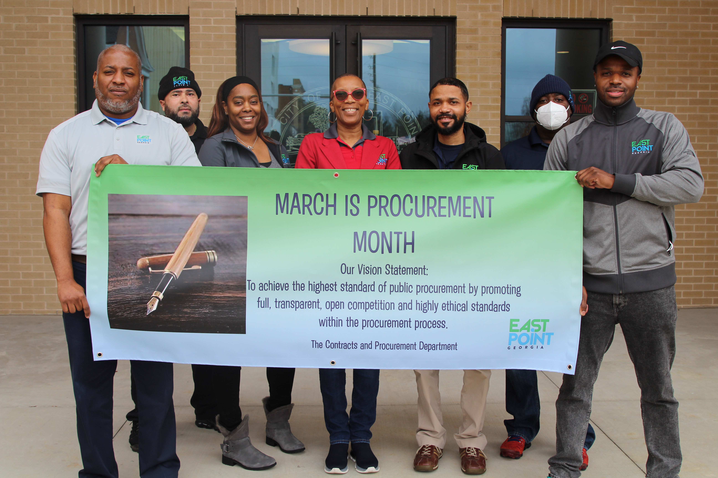
C&P Team
Thank you for attending!
Yolanda Broome, J.D.,CPP, Director
Diandra Taylor, GCPA, Buyer
Tron Jones, GCPA, GCPM, Contract Specialist
Derman Lawrence, Contract Specialist
Carl Hall, Inventory Control Specialist
Derrick Corbin, Warehouse Clerk
Kendrick Jenkins, Warehouse Clerk
Contact us at purchasing@eastpointcity.org

