Slide 1
Summary presentation

Slide 2
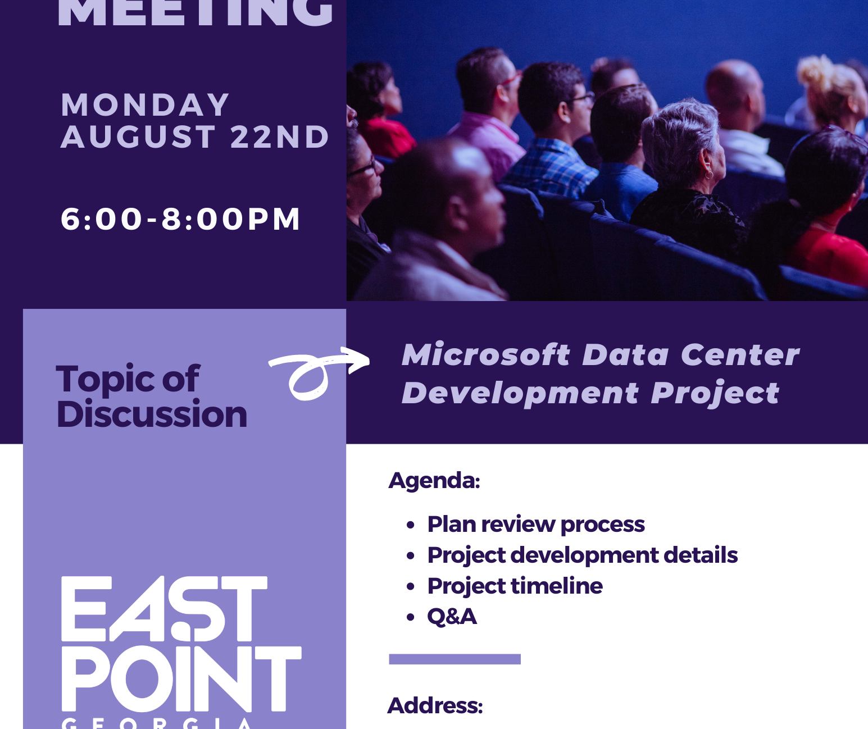
Community Meeting
Plan Review Committee

Slide 3
Agenda
Community Outreach Meeting
Monday, August 22, 2022
6:00pm – 8:00pm
Welcome + Introductions
City Representatives – Welcome City Manager Deron King
Microsoft Representatives Michael Traitor + Brendan Gallagher
Plan Review/Permitting Process
City Representatives-Technical Plan Review Committee
Project Development Details
Microsoft Representatives
Q+A
Project Time

Slide 4
Agenda
Community Outreach Meeting
Monday, August 22, 2022
6:00pm – 8:00pm
Welcome + Introductions
City Representatives – Welcome City Manager Deron King
Microsoft Representatives Michael Traitor + Brendan Gallagher
Plan Review/Permitting Process
City Representatives-Technical Plan Review Committee
Project Development Details
Microsoft Representatives
Q+A
Project Time

Slide 5
Planning and Community Development Department
Zoning Division
Permit & License Division
Building Inspection Division
Water Resources Department
City Engineering
Stormwater/Soil Erosion
Water and Sewer
Land Disturbance Permit
Commercial Pre-Treatment
Fire Marshall – Inspections
Blasting Permits
Police – Traffic
East Point Power – Electric
Arborist
Public Works Department
Transportation Engineering
Technical plan review committee (TPRC)

Slide 6
Planning and Community Development Department
Kimberly Smith, Director
Herbert Bush, Project Manager-Sr. Planner
Tayla Solomon, Associate Planner
Santo Bowles, Chief Building Official
Water Resources Department
Melissa Echevarria, Director
Richard Randolph, City Engineer
Reza Aral, City Engineer, Stormwater Division Manager
Armond Jenkins, Storm Water Coordinator
Fire Marshal – Inspections
Chief Corey Thornton
Chief Marcus Anderson
Technical plan review committee (TPRC)

Slide 7
Department of Planning + Community Development
Concept Review, Zoning, Plats, Land Disturbance-W+S, Permits-BP, Inspections-CO’s, Business License

Slide 8
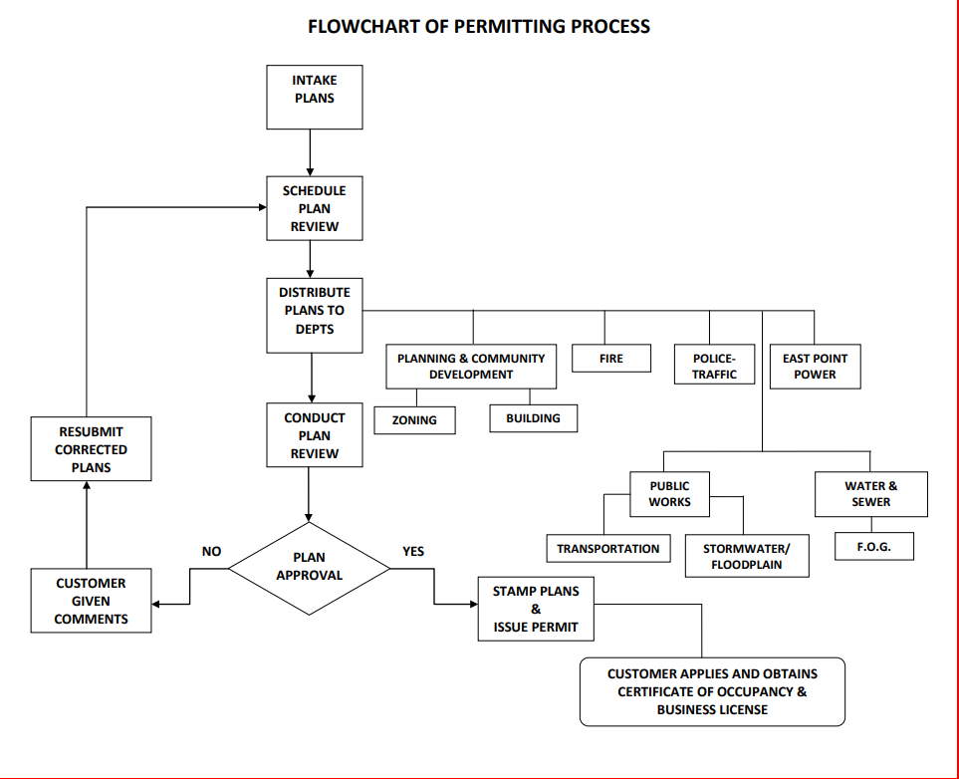

Slide 9
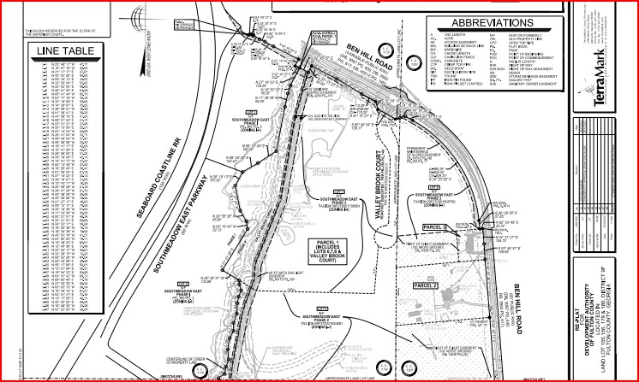
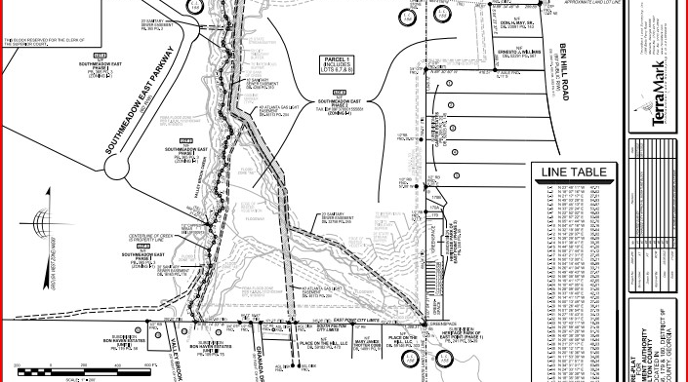
Project Permit TimeLine
Concept Meeting Spring 2021
Rezoning Summer 2021
Lot Combination-Preliminary Plat Summer 2022
Land Disturbance Summer 2022
Blasting Permits Summer – Fall 2022
Final Plat TBD
Building Permits TBD
Inspections TBD
Building Final and CO and Business License TBD

Slide 10
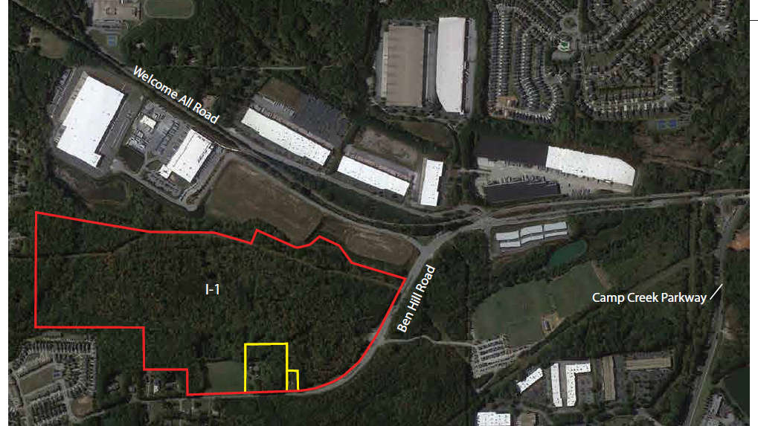
Project Permit TimeLine
Concept Meeting Spring 2021
Rezoning Summer 2021
Lot Combination-Preliminary Plat Summer 2022
Land Disturbance Summer 2022
Blasting Permits Summer – Fall 2022
Final Plat TBD
Building Permits TBD
Inspections TBD
Building Final and CO and Business License TBD

Slide 11
Building &
Inspections

Slide 12
Purpose & Intent of Building Regulations
Provide reasonable controls for the design, construction, use, occupancy and maintenance of buildings
Provides for a minimum level of safety
cannot legally be made to require construction of a quality more than necessary to furnish a reasonable degree of safety.
The term minimum should not be misconstrued to mean the acceptance of inferior or shoddy work. It simply means work that provides the very minimum acceptable level of safety.

Slide 13
Water and Sewer Department
Land disturbance Permitting, Stormwater, City Engineering, Soil Erosion and Sedimentation

Slide 14
Water Resources Department (Water, Sewer and Storm Water)
Storm Water Management
Ensure Compliance with Federal, State and City Floodplain Ordinance.
Comply with Georgia Storm Water Management Manual and City Ordinance for water quality and water quantity.
Provide technical guidance and engineering for Storm Water Division

Slide 15
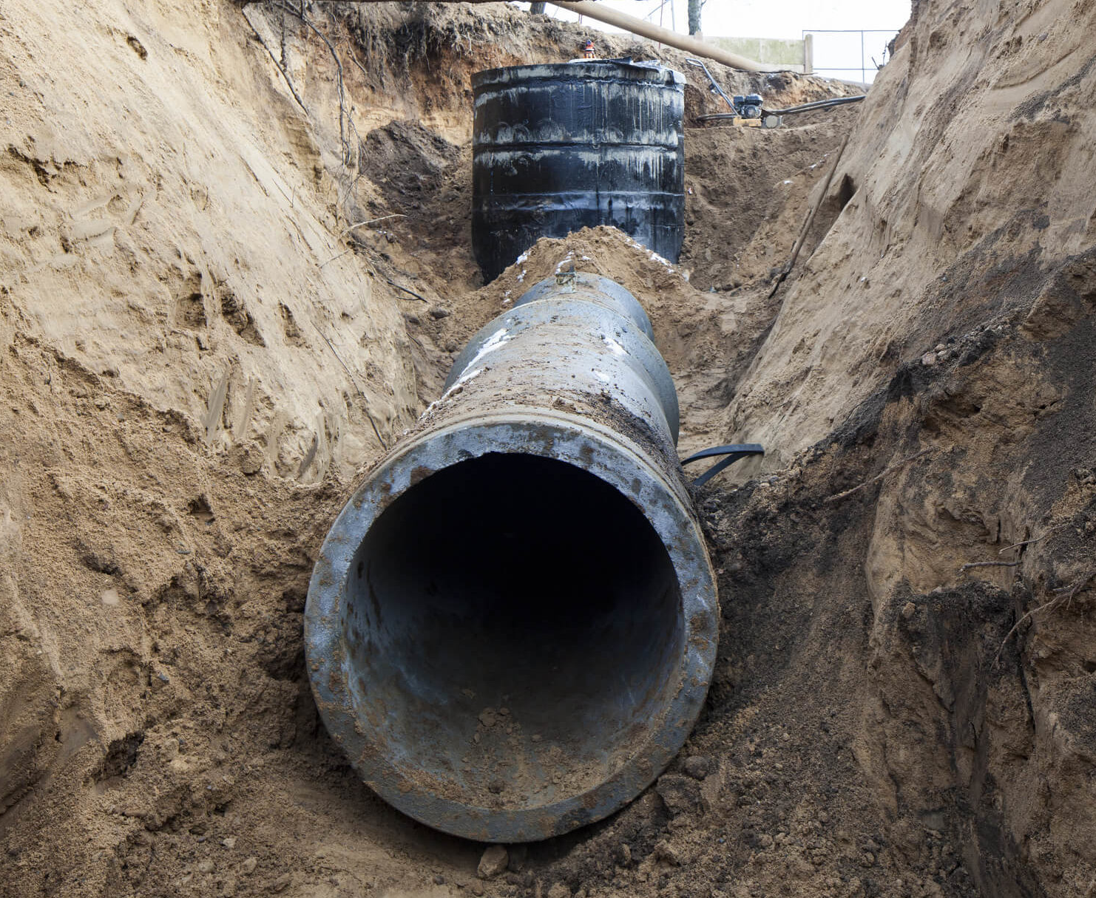
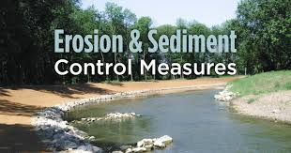
Water resource department Environmental Compliance
Ensure the city meets the compliance standards for the Georgia Erosion and Sedimentation Act regarding Land Disturbance Permitting, Inspections and Sampling in accordance with the projects Notice of Intent from project start to completion.
Project plans with land disturbance under an acre must be approved by the city
Project plans with land disturbance over an acre must be approved by the city and the state
Approval documentation from the EPD is required for construction activities disturbing more than 50 acres
Approved plans, LDP documentation, performance bond and a pre-construction meeting is required prior to construction activity (land disturbance)
Maintenance bond is required after the completion of the project
Project with the inclusion of retaining walls are certified and inspected by a third-party Professional Engineer P.E.
Third party P.E. must provide inspection reports signed by a P.E.

Slide 16
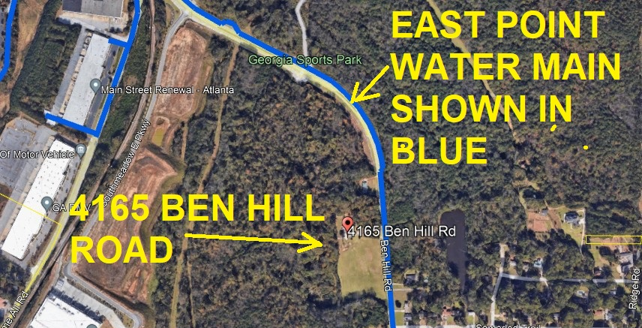
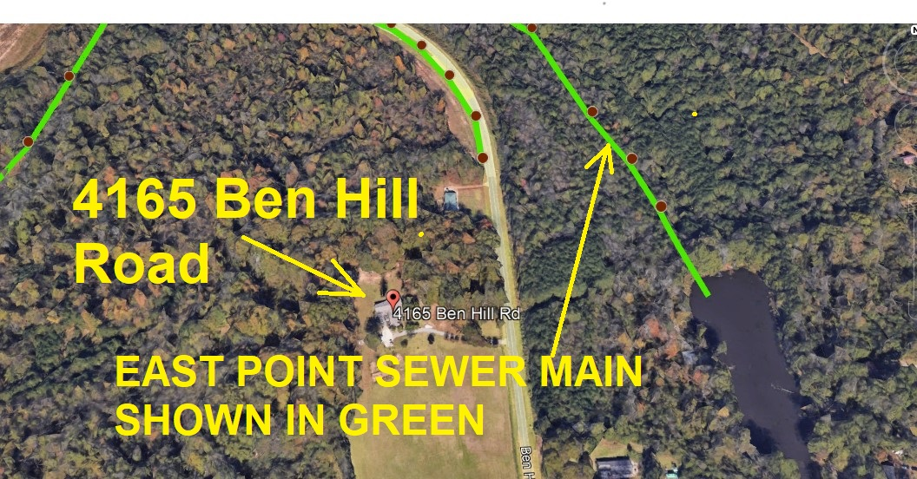
Water Resources Department Water and Sewer
Ensure protection of city water and sewer distribution system. Ensure site meets city compliance standards for water and sewer construction.
Provide aerial mapping of blasting location.
Provide Pre and Post CCTV of city’s sewer main to ensure the lines remain intact with no damage.
Provide Leak Detection for areas of water main in close proximity to blasting.

Slide 17
Water and Sewer
Issues LAND DISTURBANCE PERMITS

Slide 18
Fire Department-Blasting Permit

Slide 19
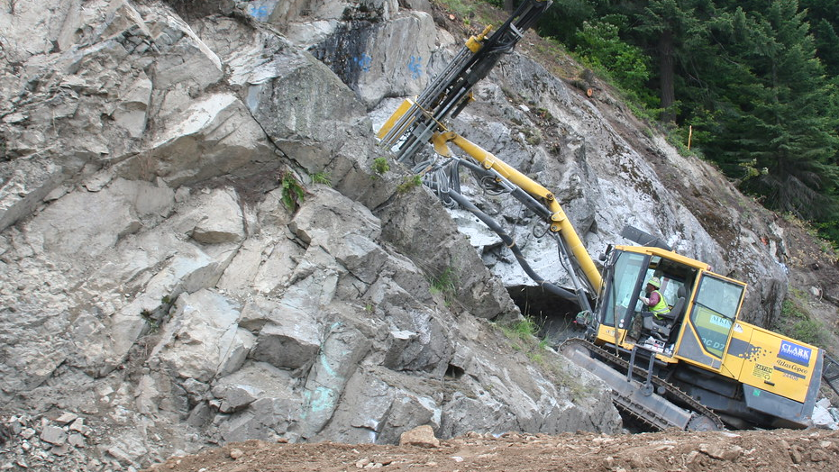
Fire Department – plan Review
There are many different conditions and variables to new construction, especially in Georgia. Rock and stone rugged terrain creates challenges to builders and, at times, blasting is necessary for the build.
When a construction job requires blasting, a blasting permit is necessary. The East Point City Fire Department is involved in the plan review process and issues permits for builders in the city limits.
This Photo by Unknown Author is licensed under CC BY-NC-ND

Slide 20
Fire department – plan review
Blasting Permit Process
Applicants request a Blasting Permit, by submitting their request with all required license & permits to the City of East Point Fire Department.
In addition, applicant makes a request to the City of East Point Water & Sewer Department for infrastructure integrity testing.
Once approved by Water & Sewer, the Blasting Permit is issued by the fire department after the site is inspected by the fire department and is valid for 7 days – if additional time is needed, a new applications is submitted, and additional fees are paid.

Slide 21
Microsoft data center development project
Project Timeline and Project Development Details

Slide 22
Microsoft data center development project
Questions + Answers

