Slide 1
Proposal Writing 101
For east point businesses
August 17, 2022 10am-12noon

Slide 2
Proposal Writing 101 - Agenda
The RFP | Your response | organization | checklist
RFP General Instructions | Make sure you are registered with Ion Wave Technologies | In order of appearance in the RFP | Follow checklist provided
RFP Base Document – note the important dates | Save all credentials and other documents you need to your computer | Exhibit order | Titles should match RFP
Exhibits | Write your proposal using: Project Description Scope of Work Evaluation Criteria | Attach documents (.pdf) and upload into Ion Wave Technologies | Not applicable items should be labeled “N/A”
Notes:
Yolanda – wouldn’t this slide need to be updated? I am thinking my portion would fit better in the end – since I will be discussing best practices.

Slide 3
Proposal Writing 101 – Best Practices
Organizing your proposal and sections
Writing a winning proposal (what to write about)
Formatting responses

Slide 4
What A Proposal Isn’t
A Technical Report
An Academic Study
Not Just Paperwork
Not all about YOU – it’s about your client/customer

Slide 5
What A Proposal Is
A marketing document
Responds to the stated needs of your customer
A legal document and project plan

Slide 6
RFP Sample Case Study: Workers’ Compensation Third Party Claims Administrator
Submittal Instructions
Exhibit “A” Project Overview
Exhibit “B” Schedule
Exhibit “C” Scope of Work and Deliverables
Exhibit “D” Evaluation Criteria and Scoring Metrics
Exhibit “F” Submittal Requirements
Notes:
Will only show examples of Submittal instructions and Exhibit F. And will talk through the importance of reviewing these key components of the submittal as a proposal writer.

Slide 7
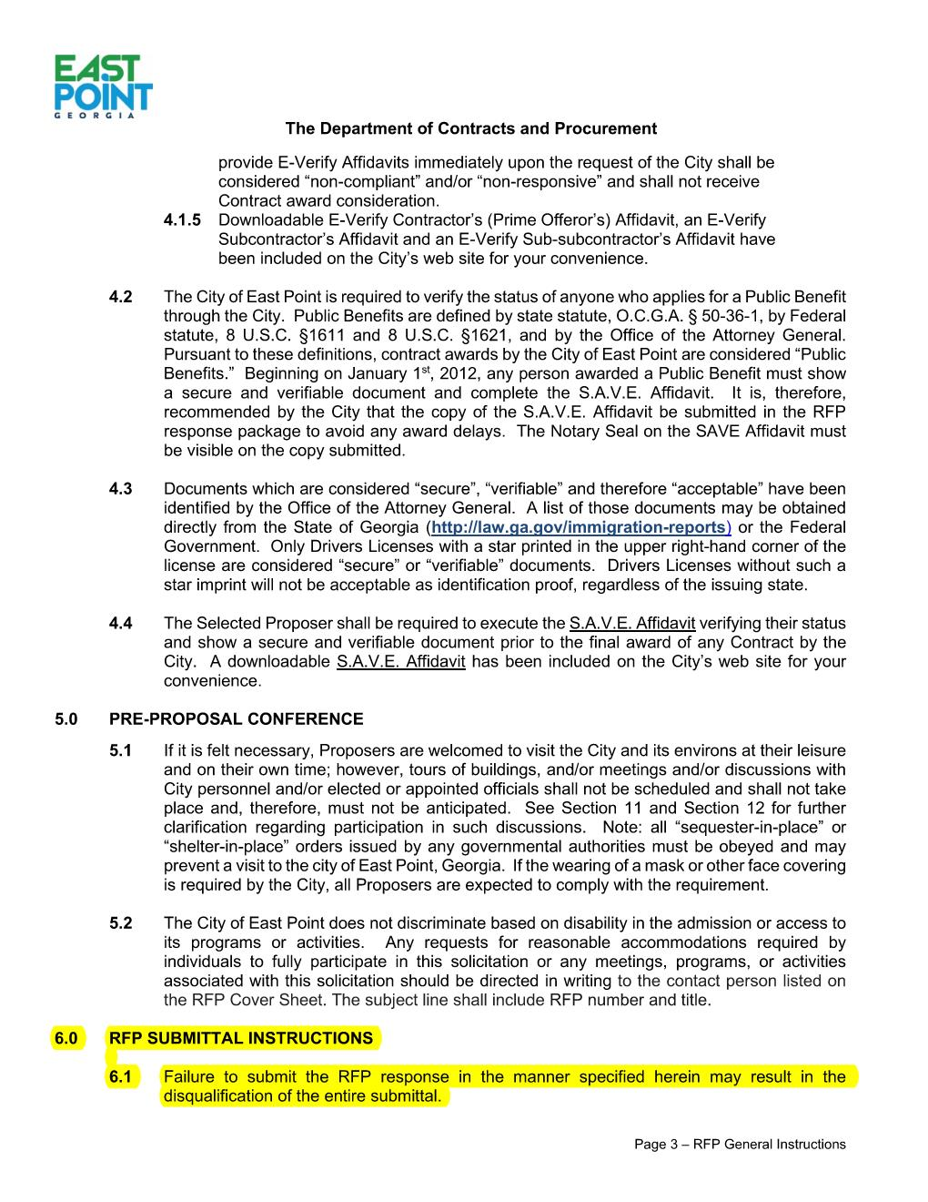
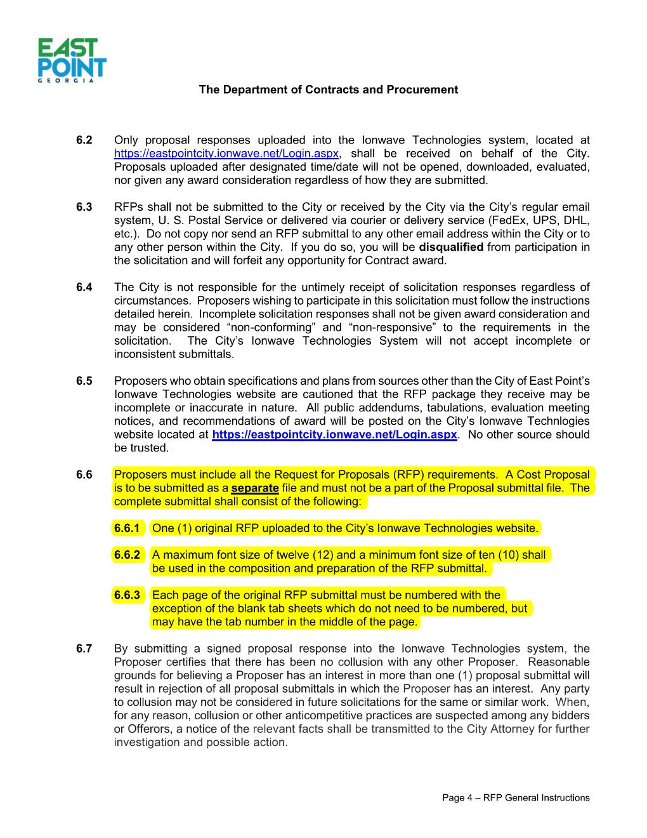
RFP Sample Case Study: Workers’ Compensation Third Party Claims Administrator

Slide 8
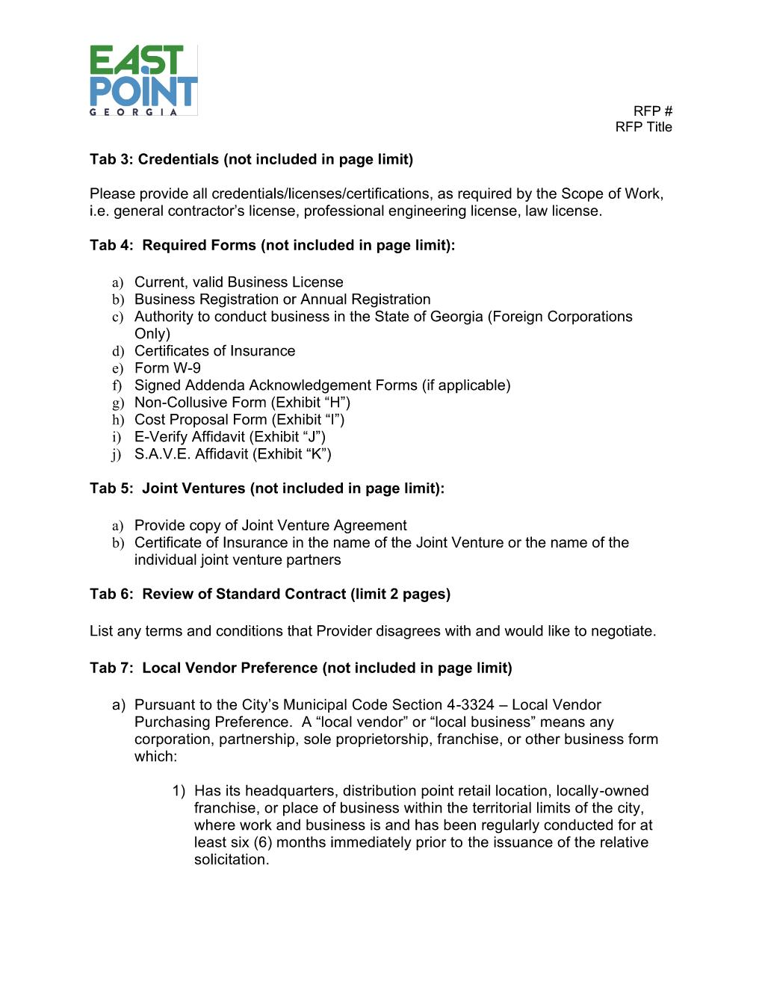
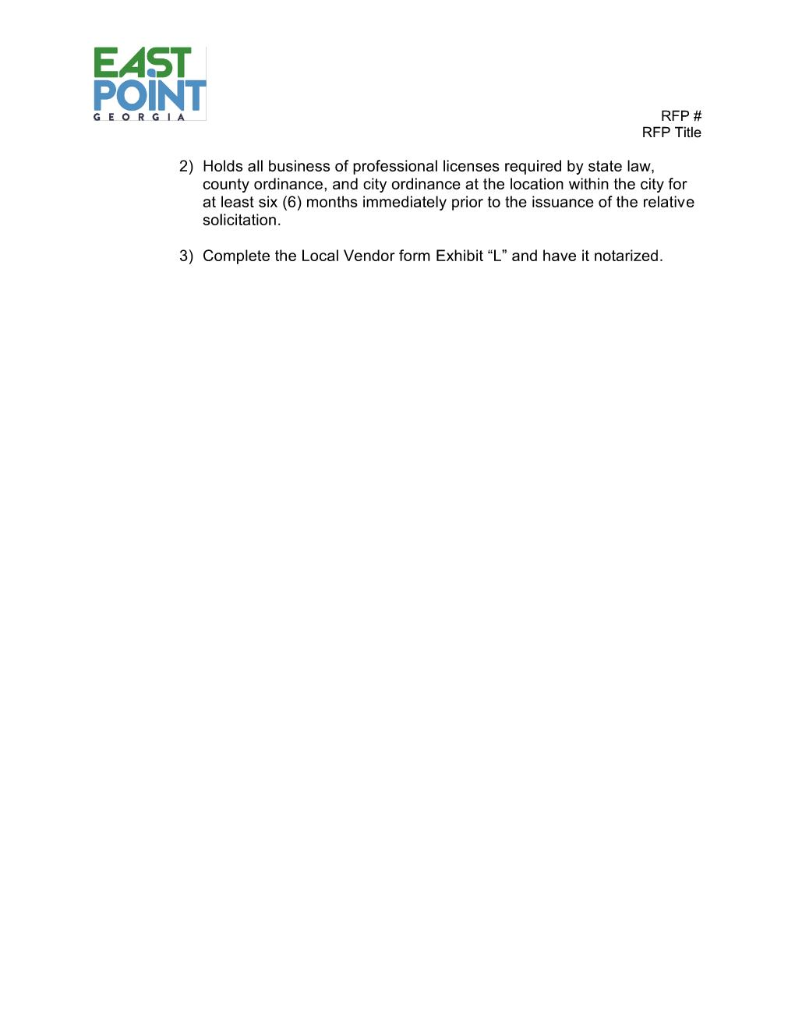
RFP Sample Case Study: Workers’ Compensation Third Party Claims Administrator

Slide 9
Tips For Organizing Your Proposal
Develop a Proposal Outline
Conduct a Proposal Strategy Session
Develop a Work Plan

Slide 10
Sample Proposal Outline/Work Plan*
*Sample outline only covers Tabs 1 and 2 of RFP
Notes:
Note – I am only focused on the First 2 tabs (out of the 7 tabs) as an example only….

Slide 11
Tips For Writing A Winning Proposal
Include
Include Issue Feature Benefit Proof in Transmittal Letter
Tell
Tell A Story
Write
Write Simply and Clearly
Spotlight
Spotlight Your Subject Matter Experts
Use
Use Graphics

Slide 12
Require a RED TEAM Review!!!
Provides constructive and objective feedback on:
If RFP requirements are covered
If proposal themes are effective
Quality of project management plans
Effectiveness of writing and graphics
Whether or not key elements are missing
Notes:
I

Slide 13
Tips for Formatting
ALWAYS follow the RFP submittal instructions
Use easy to read fonts for online or hard copy submittals
Use graphics
Always include a cover page, table of contents, and tabs
Don’t overuse your company’s name throughout your proposal
Use your client logo in headers or footers
Use plenty of white space
Notes:
First

Slide 14
The RFP General Instructions
See this document on Ion Wave Technologies (you must log in to see it)
Note the following important instructions:
Registration is required!
Addenda
Submittal instructions
Do not email responses
Conferences
Presentations/Interviews
Contract Award
Non-responsiveness

Slide 15
The Base RFP Document
RFP Number
RFP Title
Contact Person’s name and email address
Inquiries
Ethic Requirements
The “No Contact” Rule
List of Exhibits:
A - Project Overview
B - Schedule
C - Scope of Work
D - Evaluation Criteria and Scoring Metrics
E - Reference Sheet
F - Technical Requirements
G - Sample Contract with Insurance Requirements
H – Non-Collusion Affidavit
I – Cost Proposal Form
J – E-Verify Affidavit
K – S.A.V.E. Affidavit
L – Local Vendor Preference Eligibility Affidavit

Slide 16
Exhibit “A” Project Overview
This is a description of the project.
You may wish to use some of this information when writing your proposal.

Slide 17
Exhibit “B” Schedule
Important Events:
Advertisement date
Pre-proposal conference date and time – will indicate whether mandatory
Question deadline date and time
Proposal Due Date and Time

Slide 18
Exhibit “C” – Scope of Work
Use the scope to write your proposal!
1. What is the City looking for?
2. Have you done it before?
3. Do you know of new and innovative ways to deliver the project?
4. Can you provide the deliverables?
5. Do you have questions? Submit them.

Slide 19
Exhibit “D” Evaluation Criteria and Scoring Metrics
Use the criteria to write your proposal:
1. Previous experience – talk about your wins!
2. Qualifications and experience – include resumes, certifications, and project descriptions.
3. Your approach and plan to meet the RFP requirements – see SOW.
4. References – copy the reference sheet and complete Section 1 for each reference.
5. Local Vendor – don’t leave 5 points on the table!
6. Cost – fair and complete. Do not rely on change orders.

Slide 20
Exhibit “D” cont. Point Values
Evaluation Criteria | Point Values
Previous experience | 0 to 30 Points
Qualifications and experience of personnel | 0 to 25 Points
Project approach and plan | 0 to 20 Points
References | 0 to 10 Points
Local Vendor Preference | 0 or 5 Points
Cost | 0 to 10 Points
Total Possible Points | 100 Points
Scoring Metrics - An Evaluation Committee will be responsible for ranking and recommending the most qualified firm(s) using the following criteria and point values on the right.
The Evaluation Committee shall be comprised of at least three (3) individuals and no more than five (5) individuals. The Committee shall review the submittals and score using the scoring metrics above. The Evaluation Committee will rank the submittals and determine whether interviews are necessary. The Committee will recommend to the Requesting Department the most qualified firm(s) based on the submittals. The Department will make a recommendation of award to the City Council. The City Council has the authority to make any award that is in the best interest of the City.
At the conclusion of evaluation process, the Proposers may be asked to submit in writing, a Best And Final Offer (BAFO). After the BAFO is submitted, the proposals will be rescored as to cost and the decision to award will be based on the final scores including the BAFO.
The Selected Provider(s) shall enter into the Professional Service Agreement (“Contract”) that is provided a sample with the solicitation.

Slide 21
Exhibit “E” - Reference Form

Slide 22
Exhibit “F” Submittal Requirements
Exhibit “F”
Submittal Requirements
Instructions:
Complete Provider’s Contact Sheet using the subject: RFP No. 2022-XXXX – RFP TITLE
Create a Table of Contents
Organize the submittal based on the following seven (7) tabs:
Tab 1: Letter of Transmittal shall include: (limit 2 pages)
The Provider’s business organization type (i.e. corporation, LLC, partnership, etc.).
The state of incorporation or organization.
The name and address of the partners and indicate whether each partner is a general partner or limited partner, if applicable.
The parent corporation (name and address), if applicable.
Names and positions of the corporate officers.
Statement as to whether the company is local, regional, national, or international.
The names and addresses of company affiliations and/or subsidiaries.
The address and telephone number of the Primary Office/Headquarters.
The address and telephone number of the office responsible to provide the solicited services.
If different elements of the work/services will be accomplished at different locations, those locations must be listed along with their areas of responsibility.
The letter shall be signed by a representative who is authorized to contractually bind the Responder and shall include the agent’s title or authority.
Tab 2: Elements of the Proposal: (limit 20 pages)
Refer to Section 3.0 Submittal Guidelines of the RFP General Instructions.
Previous Experience in Performing Similar Projects:
Four (4) similar projects
Within the last five (5) years
With two of the four projects delivered to government or quasi-governmental entities
Qualification and Experience of Management:
Include resumes,
Certifications, and
Experience relevant to the scope of work in this RFP.
Approach and Plan to Meet the RFP requirements:
Include a project plan and
Detailed explanation regarding how the deliverables will be completed.
Tab 3: Credentials (not included in page limit)
Please provide all credentials/licenses/certifications, as required by the Scope of Work, i.e. general contractor’s license, professional engineering license, law license.
Tab 4: Required Forms (not included in page limit):
Current, valid Business License
Business Registration or Annual Registration
Authority to conduct business in the State of Georgia (Foreign Corporations Only)
Certificates of Insurance
Form W-9
Signed Addenda Acknowledgement Forms (if applicable)
Non-Collusive Form (Exhibit “H”)
Cost Proposal Form (Exhibit “I”)
E-Verify Affidavit (Exhibit “J”)
S.A.V.E. Affidavit (Exhibit “K”)
Tab 5: Joint Ventures (not included in page limit):
Provide copy of Joint Venture Agreement
Certificate of Insurance in the name of the Joint Venture or the name of the individual joint venture partners
Tab 6: Review of Standard Contract (limit 2 pages)
List any terms and conditions that Provider disagrees with and would like to negotiate.
Not including the Submittal Requirements may cause your proposal to be deemed “Non-Responsive.” Non-responsive proposals are not evaluated.

Slide 23
Exhibit “F” cont. Technical Requirements
Tab 7: Local Vendor Preference (not included in page limit)
a) Pursuant to the City’s Municipal Code Section 4-3324 – Local Vendor Purchasing Preference. A “local vendor” or “local business” means any corporation, partnership, sole proprietorship, franchise, or other business form which:
b) Has its headquarters, distribution point retail location, locally-owned franchise, or place of business within the territorial limits of the city, where work and business is and has been regularly conducted for at least six (6) months immediately prior to the issuance of the relative solicitation.
c) Holds all business of professional licenses required by state law, county ordinance, and city ordinance at the location within the city for at least six (6) months immediately prior to the issuance of the relative solicitation.
d) Complete the Local Vendor form Exhibit “L” and have it notarized.
Tab 6 – Local Vendor Preference

Slide 24
Exhibit “G” Sample Contract
Sample contract (see handout)
With insurance requirements
1. Do not sign – this is a sample
2. Review
3. Create a list of exceptions that you wish to negotiate, if any.
4. Include a sheet in your response:
Exhibit “G” No Exceptions to Sample Contract or Exhibit “G” List of Sample Contract Exceptions.
1. Send to your insurance agent
2. You may include a “sample certificate” which is one that does not list the City of East Point as the insurance holder. If you are awarded the contract, you will obtain an updated certificate.
3. Submit all questions regarding insurance before the question period expires. See Exhibit “B” – Schedule.

Slide 25
Exhibit “H” Non-Collusion Affidavit

Slide 26
Exhibit “I” Cost Proposal Form
Page 1
Page 2
Description of Services | Lump Sum Cost
 | $
Total: | $

Slide 27
Exhibit “J” – E-Verify Affidavit
See RFP General Instructions, Section 4.1.1:
“This solicitation is subject to the Georgia Security and Immigration Compliance Act. Pursuant to the Georgia Security and Immigration Compliance Act of 2006, as amended by 2011 House Bill 67, Proposers are hereby notified that all solicitations for services or work that is to be physically performed within the State of Georgia must be accompanied by proof of the Proposer’s registration, the registration of their proposed outside Proposer(s)(s) with the E-Verify Program, as well as attestation to each party’s continuing and future participation in the E-Verify Program as established by the United States Department of Homeland Security.”

Slide 28
Exhibit “K” – S.A.V.E. Affidavit
See RFP General Instructions Section 4.2:
“The City of East Point is required to verify the status of anyone who applies for a Public Benefit through the City. Public Benefits are defined by state statute, O.C.G.A. § 50-36-1, by Federal statute, 8 U.S.C. §1611 and 8 U.S.C. §1621, and by the Office of the Attorney General. Pursuant to these definitions, contract awards by the City of East Point are considered “Public Benefits.” Beginning on January 1st, 2012, any person awarded a Public Benefit must show a secure and verifiable document and complete the S.A.V.E. Affidavit. It is, therefore, recommended by the City that the copy of the S.A.V.E. Affidavit be submitted in the RFP response package to avoid any award delays. The Notary Seal on the SAVE Affidavit must be visible on the copy submitted.”

Slide 29
Exhibit “L” – Local Vendor Preference Eligibility Affidavit
The Procurement Code of The City of East Point (Ord. No. 1111-95, § 1, 7-3-95) Secs. 4-3324. - Local vendor purchasing preference.
(Excerpted)
(2) Definition: A “local vendor" or “local business" means any corporation, partnership, sole proprietorship, franchise, or other business form which:
(a) Has its headquarters, distribution point, retail location, locally-owned franchise, or place of business within the territorial limits of the city, where work and business is and has been regularly conducted for at least six (6) months immediately prior to the issuance of the request for competitive proposals by the city; and
(b) Holds all business or professional licenses required by state law, county ordinance, and city ordinance at the location within the city for at least six (6) months immediately prior to the issuance of the request for competitive proposals by the city.
(3) Application of local preference to specific procurement activity: In an effort to nurture small and large businesses, create jobs, boost local economic activity, and tax revenue, the city will grant the lesser of a five-percent or five-point local preference to all otherwise responsive and responsible vendors who have an actual physical presence and direct economic relationship within the city. This provision is applicable only to the city's acquisition of materials, equipment, or services through the request for proposal (RFP) or request for qualification (RFQ) process as provided in code sections 4-3303, 4-3307, and 4-3313.

Slide 30
Exhibit “L” - Local Vendor Preference Eligibility Affidavit (cont.)

Slide 31
RESPONSE CHECKLIST (For Proponents’ use – do not include with your submittal)

Slide 32
Questions/Answers/Comments

Slide 33
More questions? Check out these resources: The Association of Proposal Management Professionals More questions? Check out these resources: The Association of Proposal Management Professionals - www.apmp.org and The Society for Marketing Professional Services - www.smps.org
purchasing@eastpointcity.org

