Slide 1
The Truth about Power Outages
East Point Power

Slide 2

Meet the East Point Power Staff
Shawn Dowe-Director
Thomas Manghram-Assistant Director
Todd Hicks-Superintendent
Lisa Persons-Project Manager
Gregory Creque-Line Foreman
Michael Hawkins-Line Foreman
EJ Hall-Tree Supervisor
Jacobe Stanley-Tree Foreman
Terrance Miller-Tree Foreman
Adarius Adams-Sys. Control Supervisor
Shauna Green-Dispatcher
Chana Smith-Office Manager

Slide 3
Technologies used to Restore your Power
The Truth about Power Outages-East Point Power

Slide 4
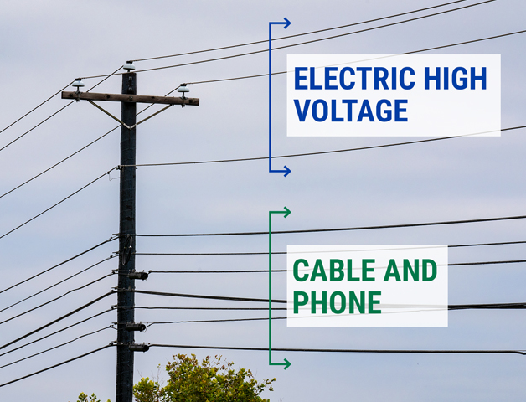
Power vs Cable Lines
How to tell the Difference

Slide 5
City Responsibility vs. Customer Responsibility

Slide 6
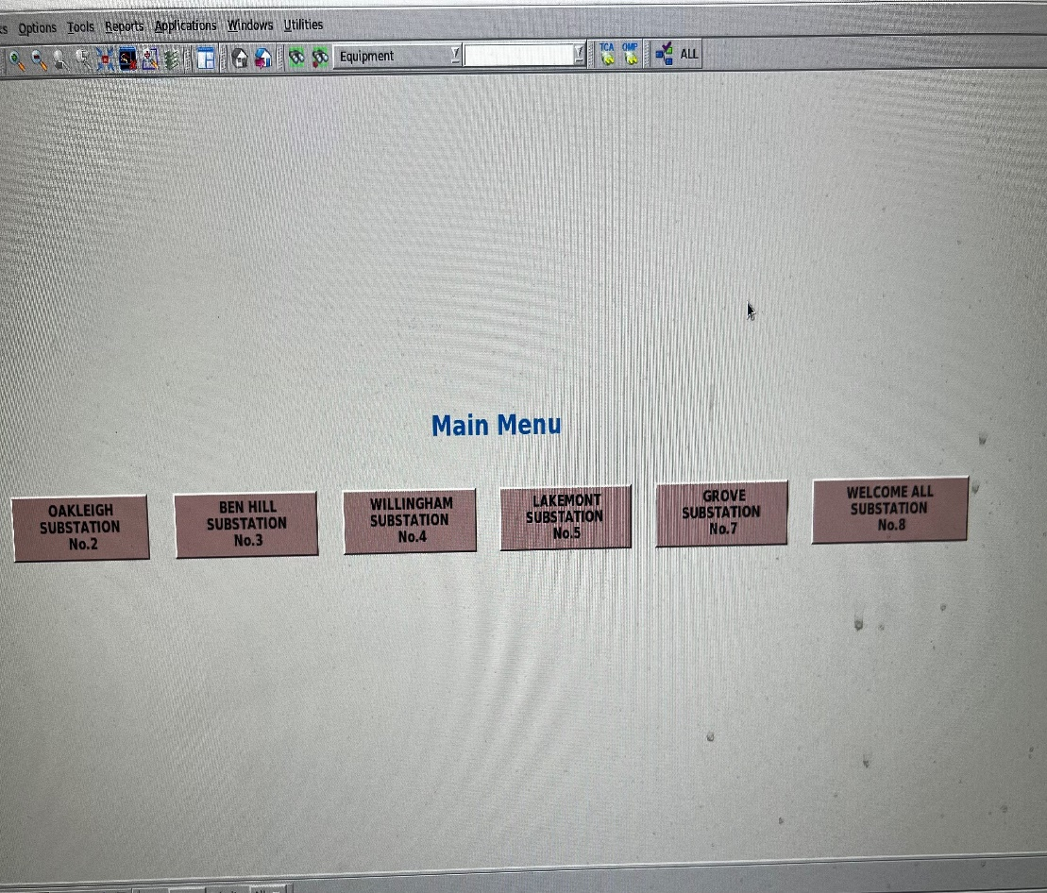
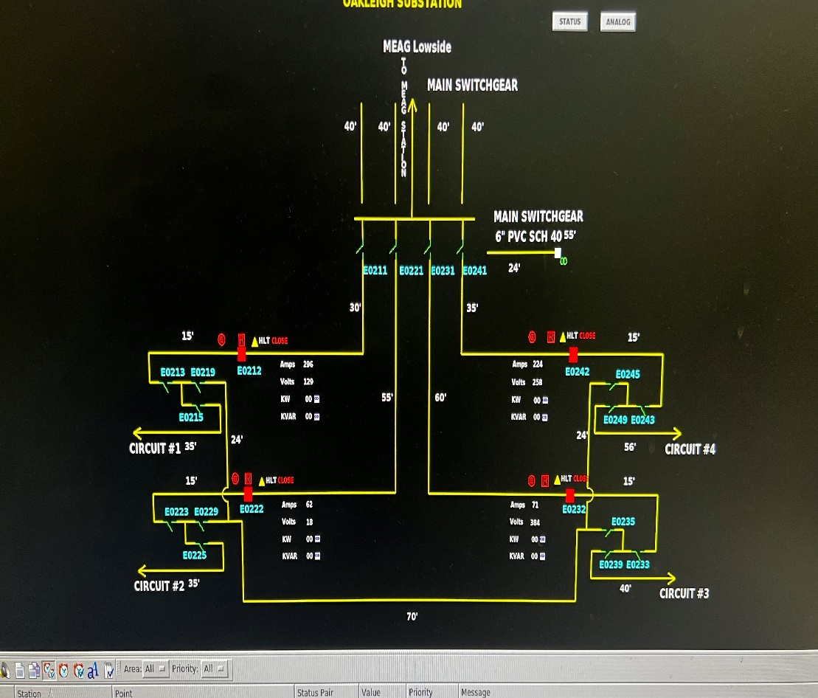
Technologies used to Restore Power
SCADA
Supervisory Control and
Data Acquisition
SCADA
Supervisory Control and
Data Acquisition

Slide 7
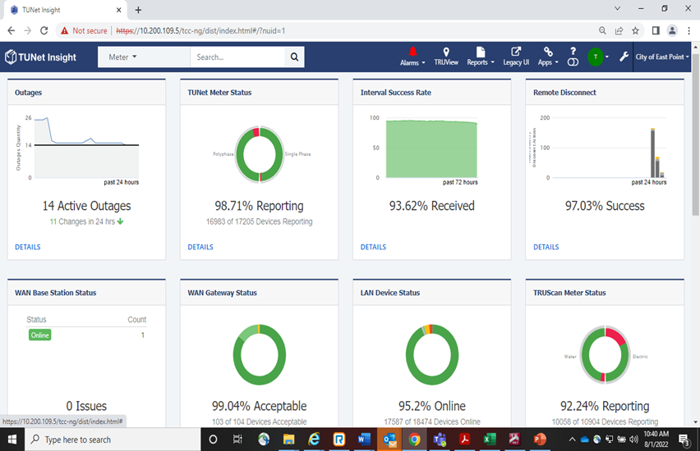
AMI (Advanced Metering Infrastructure)

Slide 8
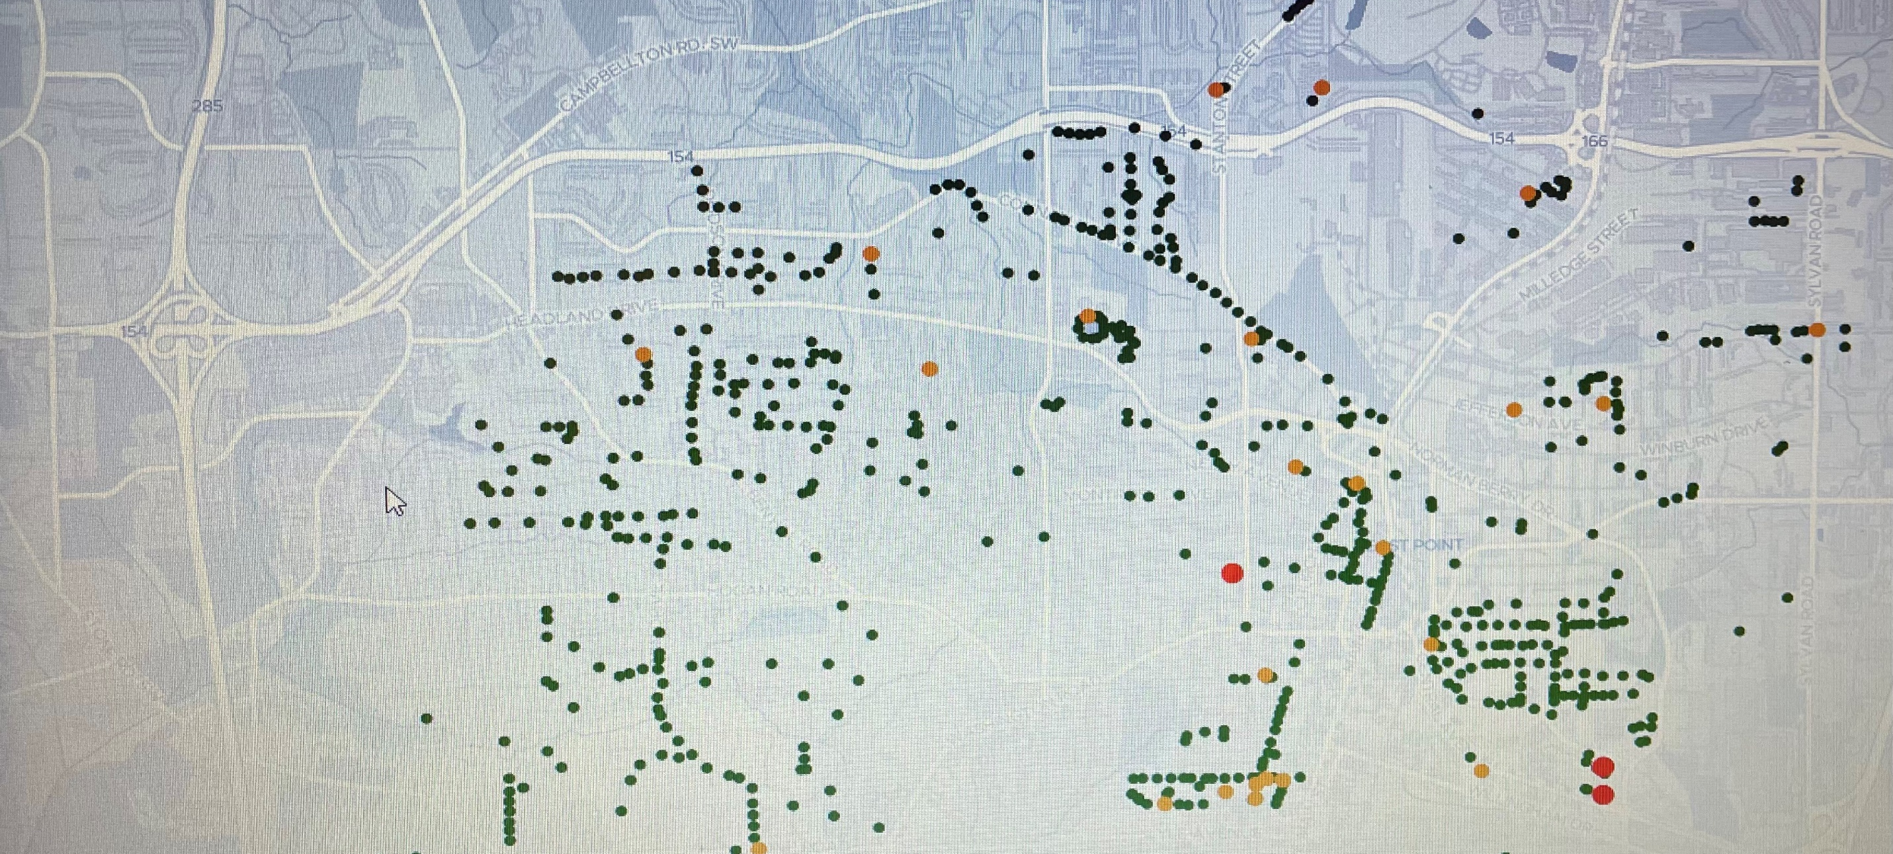
Street Light Dashboard

Slide 9
Power Outages
The Truth about Power Outages-East Point Power

Slide 10
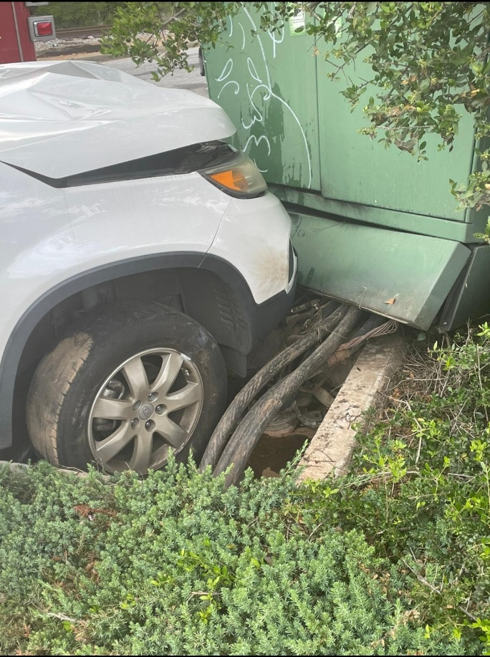
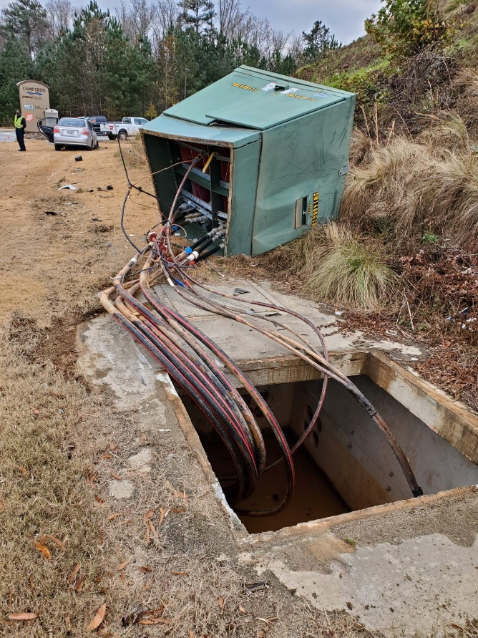
Causes of Power Outages
Vehicle accidents
Vehicle accidents

Slide 11
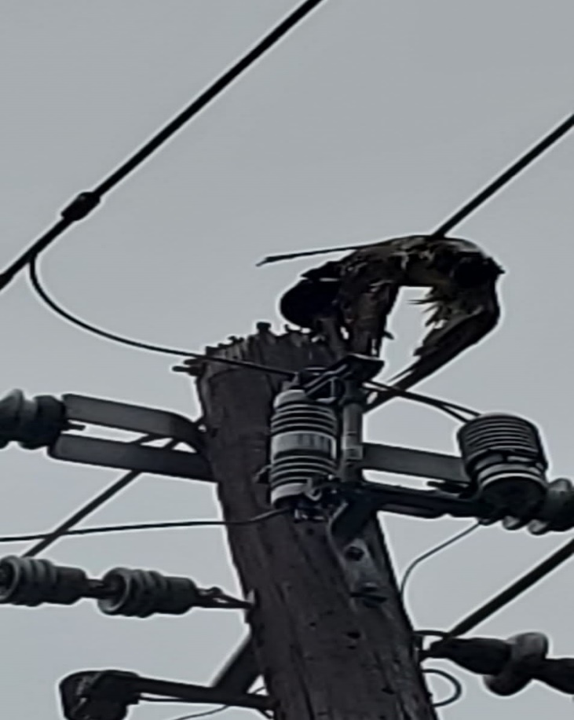
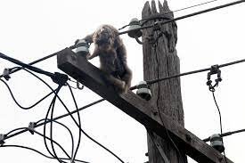
Causes of Power Outages
Dead bird on power line
Dead squirrel on power line

Slide 12
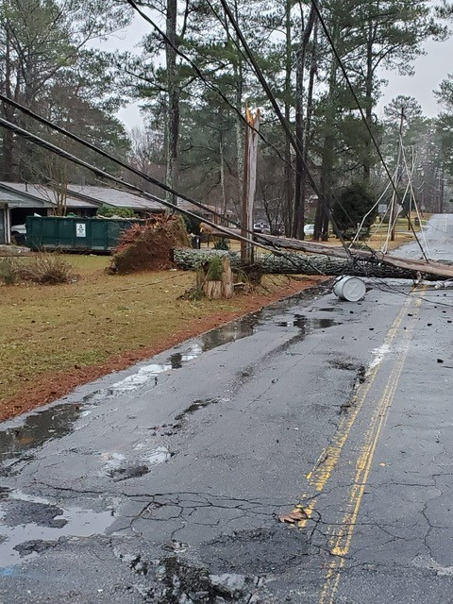
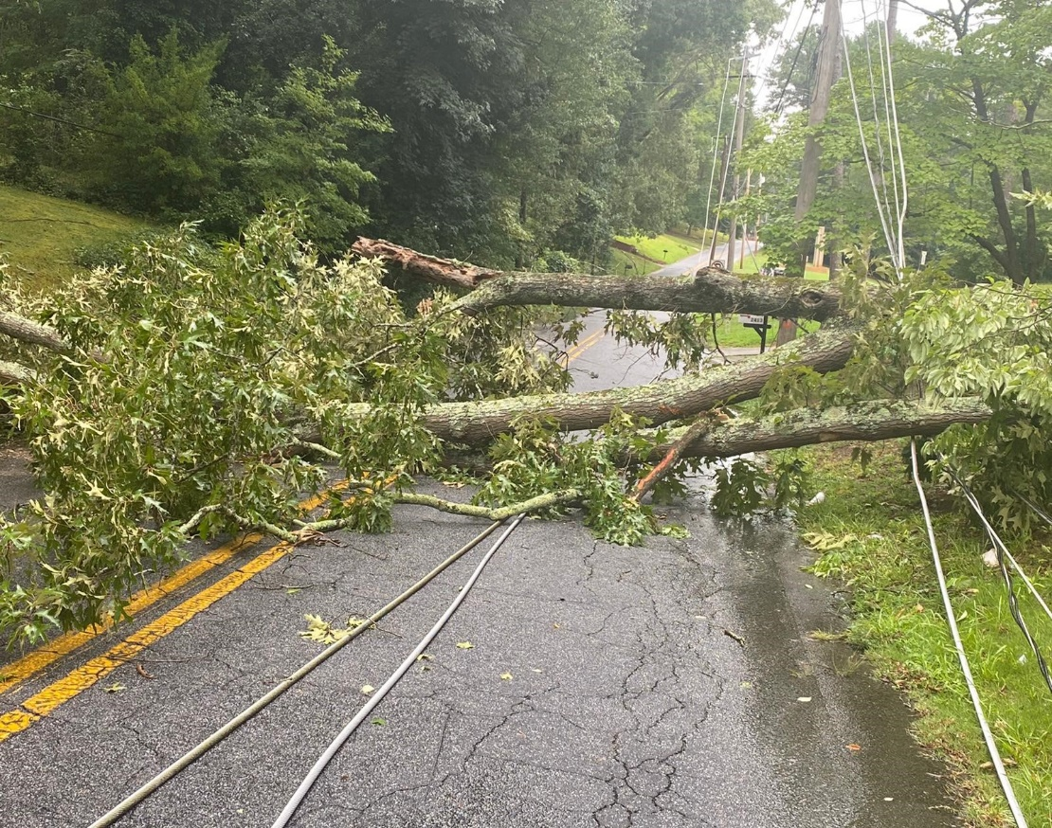
Trees
Tree fallen during storm
Fallen Tree pulling down power lines

Slide 13
How to Report a Power Outage
IUC
Reporting Power Outage
Email: poweroutage@eastpointcity.org
Phone: 404-270-7010 during normal business hours.
After Hours: dial 404-270-7010, follow the prompts given.
START
Press 1 for electric issue
Press 3 for tree issue
(if applicable)
Press 1 for live dispatcher
Press 2 to report outage
Press 1 for English, 2 for Spanish

Slide 14
Restorations
The Truth about Power Outages-East Point Power

Slide 15
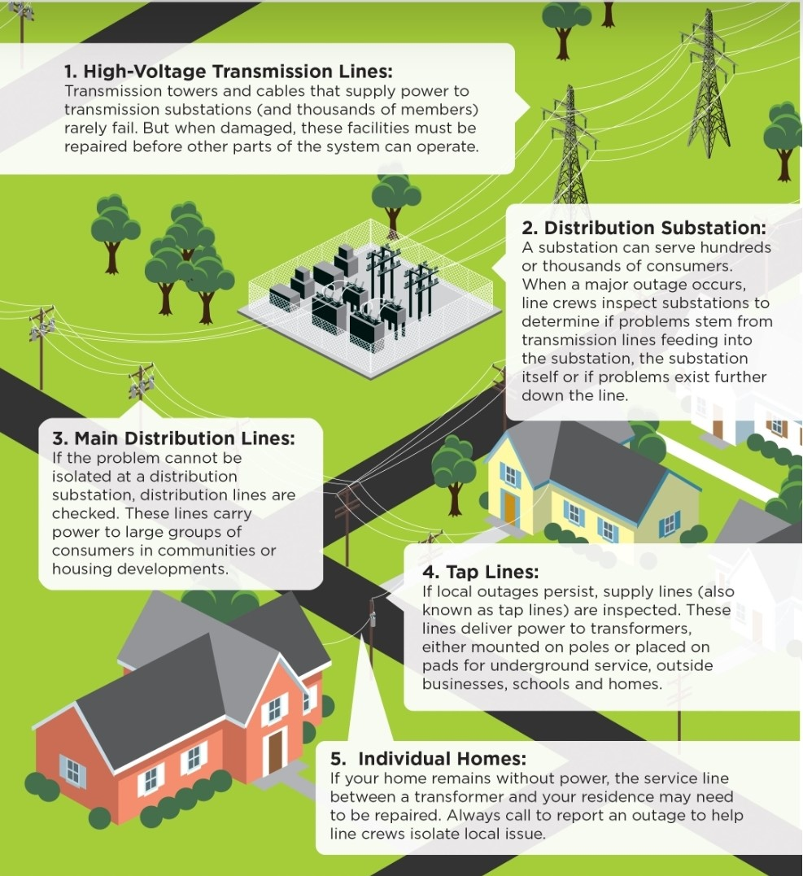
How Power Flows

Slide 16
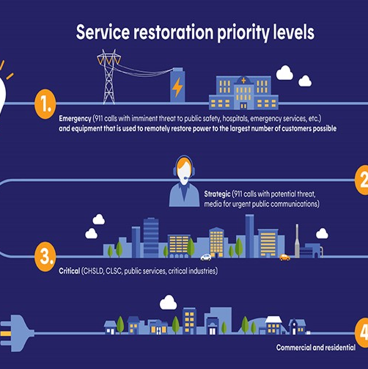
Order of Restoration
Government Complex
Schools
Citizens
Commercial Businesses

Slide 17
Frequently Asked Questions
The Truth about Power Outages-East Point Power

Slide 18
FAQ’s
What causes a power outage?
Outages are caused by several factors, primarily severe weather, fallen trees, auto accidents and objects on the line.
Is there a direct phone number to report an outage after hours?
Yes, for all power related issues and/or outages, please call (404) 270-7010. Please provide name and phone number when reporting issue.
How to report a non-functioning streetlight?
Locate pole identification number or closest street address. Place a ribbon/tape on the pole if possible. Please contact customer care to report the light outage and pole location and Number. The light will be repaired within 3-5 business days.
Power Outages

Slide 19
FAQ’s
Is the City responsible for all trees in Right-Of-Way’s?
No, by definition Right-Of-Way is the right to pass over or through property owned by someone else, usually based upon an easement. The Right-Of-Way may specify the parameters of the easement or may be a general right to pass over or through, known as a floating easement. Additionally, a Right-Of-Way may be granted only for particular purposes-for example, to repair power lines or to make deliveries to the back door of a business.
Does the city cut all limbs that are over power lines?
The main high voltage lines are maintained at 10 foot of clearance minimum where possible. Secondary voltage lines that feed buildings or houses only require trimming if contact pressure exists on the line.
Why are you trimming my trees and/or why are you trimming them so far back?
Trees are trimmed to maintain reliable power lines for you and your neighbors. Its proximity to the power lines and its rate of growth determines how much is cut.
Why are trees being cut down on some citizen’s property but not mine?
Trees are only removed on private property when they become a hazard to the power lines and public safety.
Trees

Slide 20
FAQ’s
Are all traffic signals in East Point ours?
No. All lights on Main Street, East Point St., Camp Creek, and Hwy 166 (on and off ramps) belong to GDOT (Georgia Department of Transportation). All other traffic signals within the city limits belong to East Point.
How do I report a traffic light that is not working?
For COEP lights call (404) 270-7010.
For GDOT lights call 5-1-1.
Traffic Signals

