Slide 1


Vendor Readiness
Lunch & Learn
Are you ready to do business with the City of East Point?
Presented by the Contracts & Procurement Department
November 16, 2022
11:30am – 1:00pm in the City Council Chambers

Slide 2
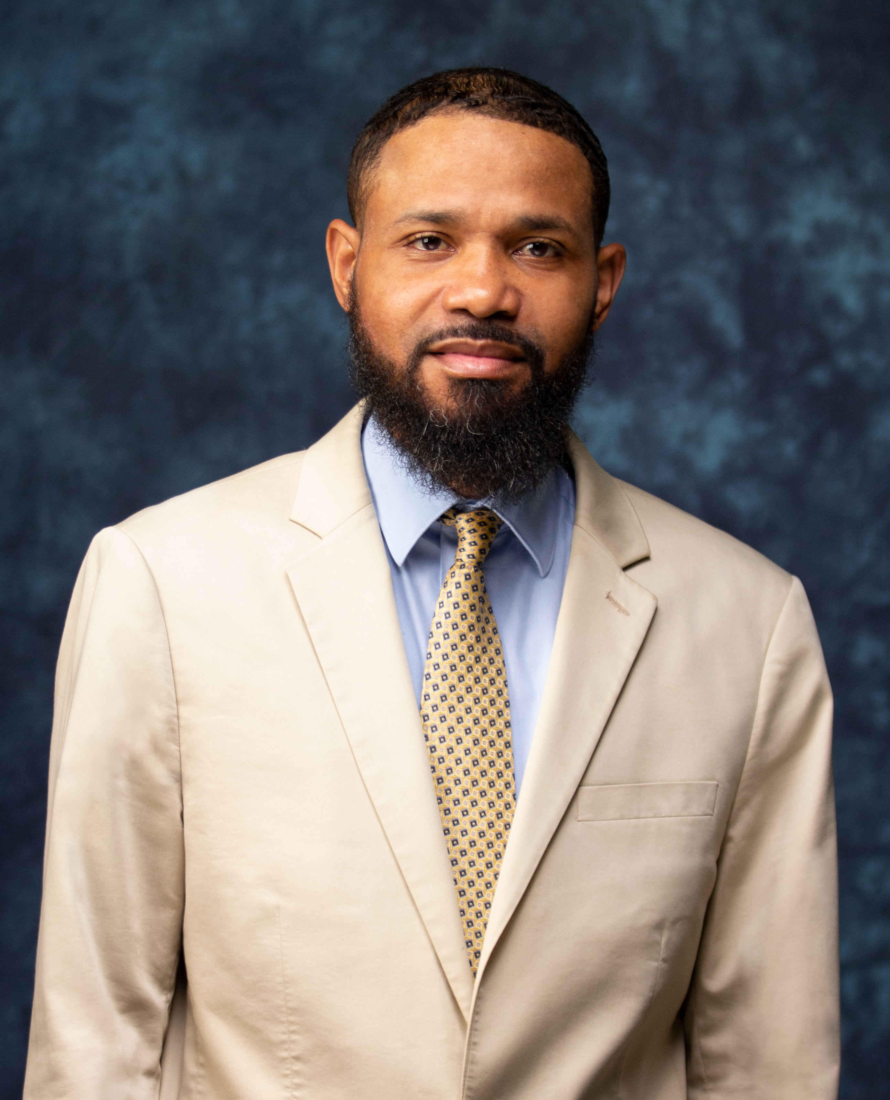
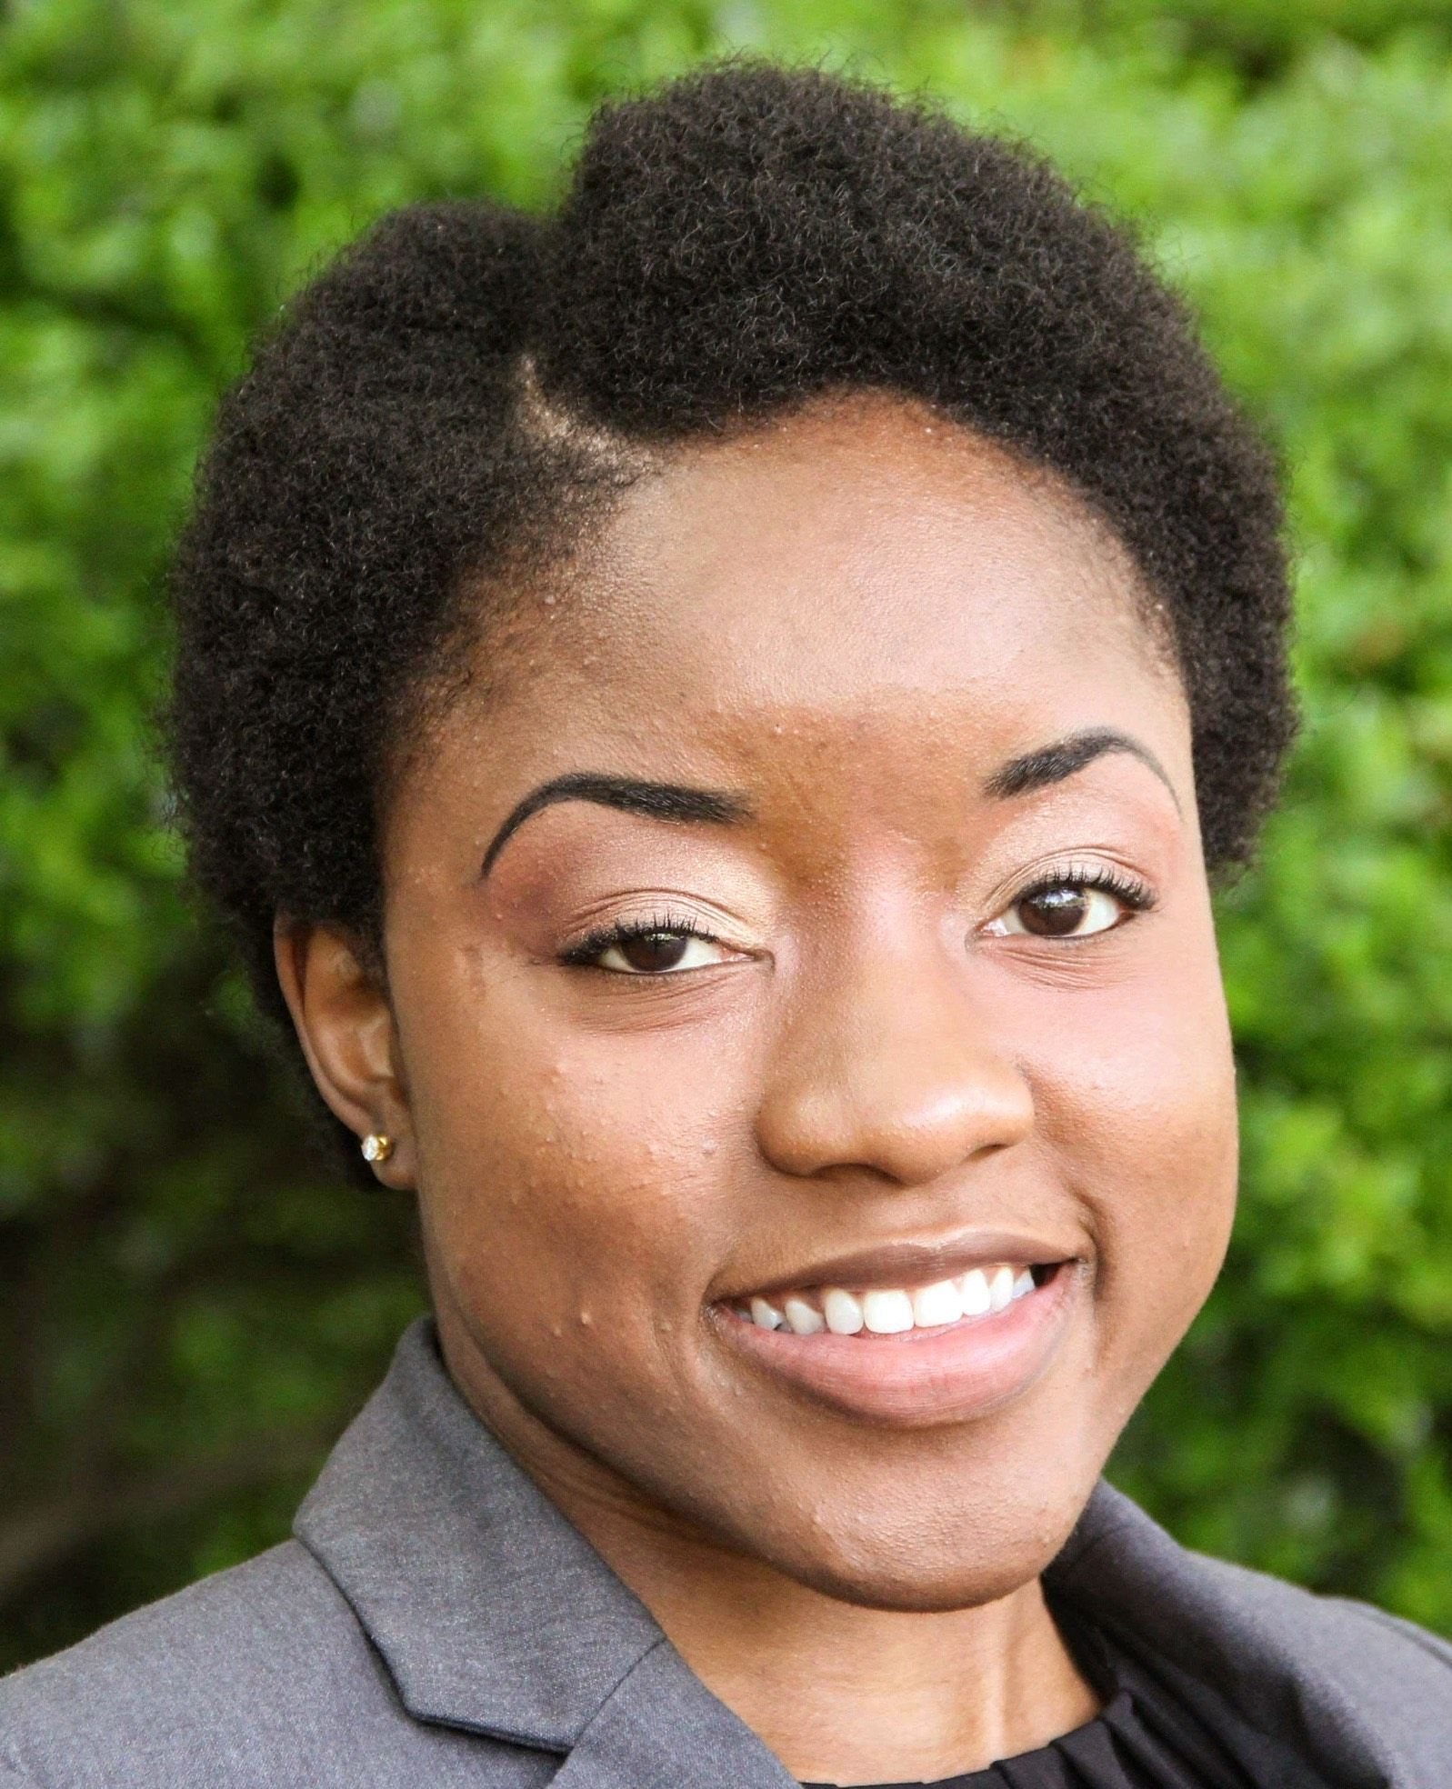
The Contracts & Procurement Team
Yolanda Broome
Director
Tron Jones
Contract Specialist
Derman Lawrence
Contract Specialist
Kawanna Woods Intern
JeKiria Bigby
Procurement Assistant

Slide 3



Previous “Vendor Talks”
Small Business Insurance
How to Register as a Vendor
Proposal Writing 101
June 2022
July 2022
Aug 2022

Slide 4



Agenda
Business Readiness
Technology
Processes & Procedures
Compliance
Business Growth & Expansion

Slide 5

Business Readiness
Business Formation and Legitimization
What’s in a name?
Licensure
Certification
Insurance
Surety Bonds
Website
Brick and Mortar vs. Home Based
Employees vs. Independent Contractors
Grand Opening

Slide 6


Technology
Website
Email
E-signature capability
Computer Software
Business vs. Personal (phones, emails, etc.)

Slide 7

The way to get started is to quit talking and begin doing.
Walt Disney

Slide 8
Stay Ready
(So You Don’t Have To Get Ready)
Processes
Procedures
The movement of people, materials, or information through a system towards accomplishment of a goal
Mapping
Analyzing
Implementation
Measurement
Maintenance
An established or official way of doing something
A series of actions conducted in a certain order or manner
Step by step instructions
In writing
Always evolving
Measure for efficiency

Slide 9
Compliance
January
Research
February
Application
Completion
March - September
Maintenance of Requirements
October
December
Annual Review of Status
Renewal or updated applications

Slide 10
Business Growth & Expansion
Capture Planning
Contract Mining
New Markets/Products
Federal, State, and/or Local
Paid subscriptions
Registering for local access to solicitations
What’s your strategy?
How much work can you handle?
You were awarded a contract – now what?
New work vs. change orders
When to expand to a new market
Do your research
How to market a new product

Slide 11



Summary
Have a strategy.
Work relentlessly.
Stay tuned in.
Excel at the little things.
Perform flawlessly.

Slide 12


Thank You
The Contracts & Procurement Team
purchasing@eastpointcity.org
www.eastpointcity.org

