Slide 1
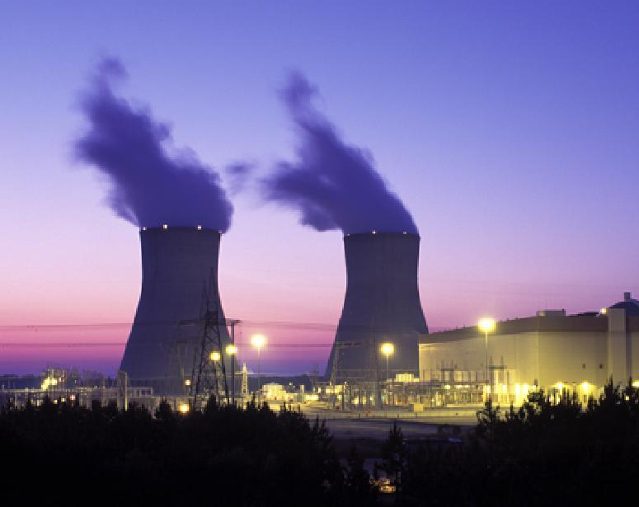

East Point Power Update
2024-2025

Slide 2
Meet the Staff
Shawn Dowe
Director
Thomas Manghram
Asst. Director
Alicia Persons
Project Manager
EJ Hall
Line Clearance Supervisor
Gregory Creque
Line Crew Supervisor
Todd Hicks
Superintendent
Michael Hawkins
Line Crew Supervisor
Adarius Adams
Sys. CTRL. Supervisor
Cassandra Sims
Delrico Wise
Meter Reader Supervisors
Shauna Green
Office Manager
Angela Champion
Dispatcher
Karen Figueroa
AMI Syst. Administrator
2 Crews
8 Member Team
Contractor
Kendal
7 Member Team
6 Member Team
U/G Contractor
U-Tec/Pike
5 Member Team
O/H Contractor
U-Tec/Pike
10 Member Team

Slide 3
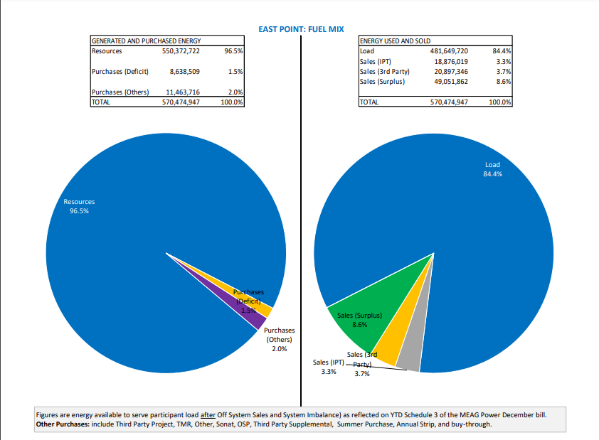
MEAG
Municipal Electric Authority of Georgia
How we obtain our power

Slide 4
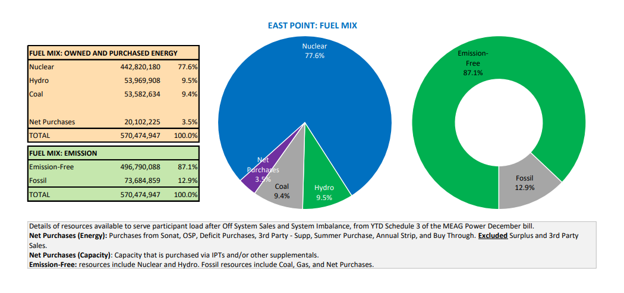

Slide 5
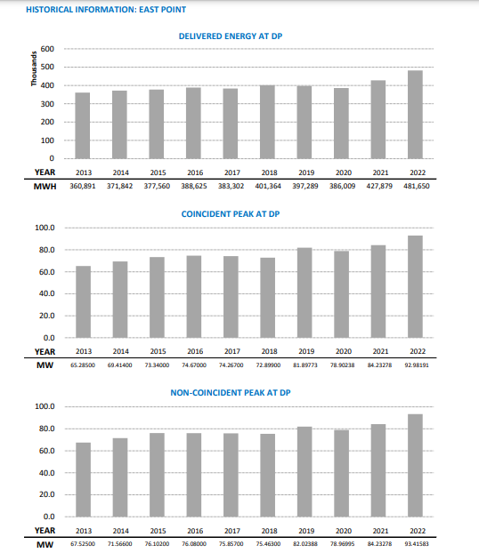

Slide 6
How we Distribute our Power
Grove Substation
circuits
e0712
e0722
e0732
Willingham Substation
circuits
e0412
e0422
e0432
e0442
Ben Hill Substation
circuits
e0312
e0322
e0332
Lakemont Substation
circuits
e0512
e0522
e0532
e0542
Oakleigh Substation
circuits
e0212
e0222
e0232
e0242
Welcome All Substation
circuits
b8312
b8422

Slide 7
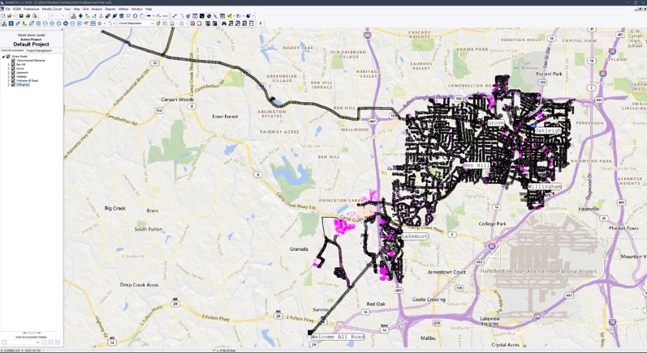
East Point Electric System

Slide 8
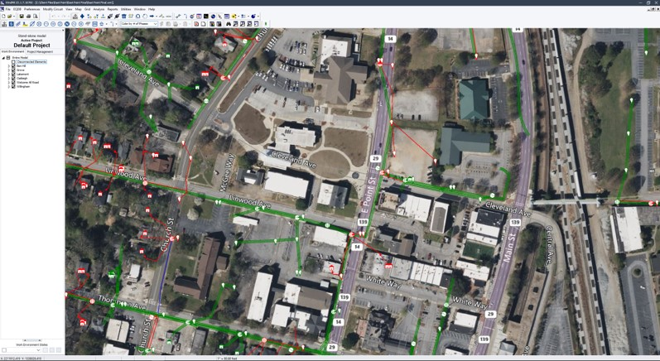
East Point Electric System

Slide 9
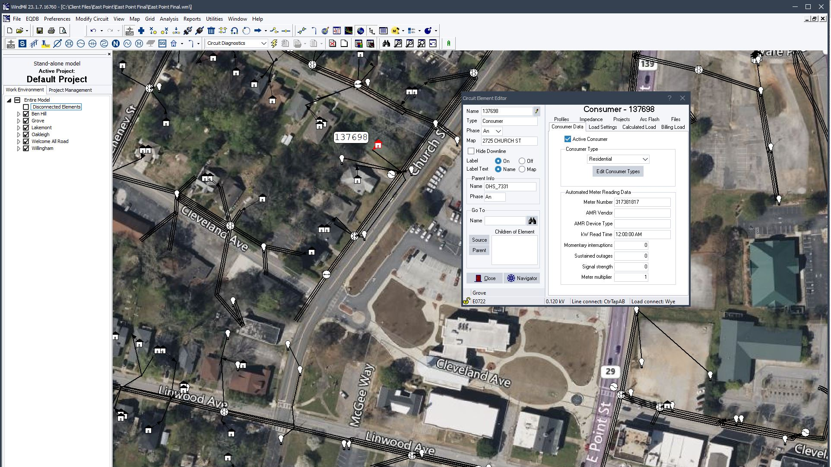
East Point Electric System

Slide 10
Grid Hardening
Overhead to Underground
Heather Drive
Ben Hill/Dodson Road
Arrowood Drive
Westchester Dr.

Slide 11
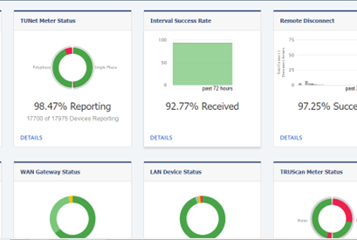
AMI Meters
The City of East Point has invested over 6 million dollars into the Advanced Meter Infrastructure, (AMI) system, which is an integrated system of smart meters, communications networks, and data management. This is a highly efficient Smart Grid platform that combines a flexible hybrid communications network with advanced applications that work together to reduce utility operational cost, improve system efficiencies, and improve customer service. AMI is automated and allows real time data.

Slide 12
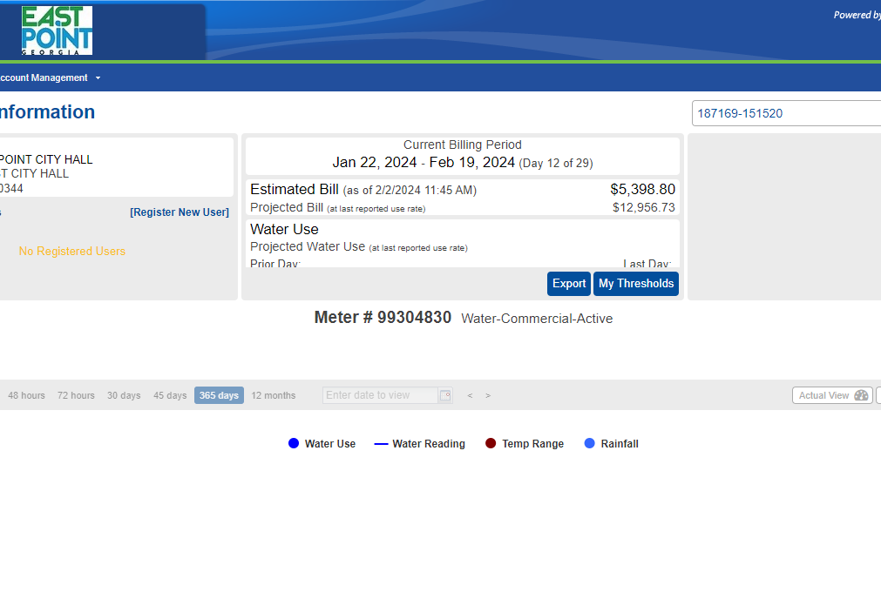
Utility Hawk
Utility Hawk is a customer portal solution that help City of East Point water and electric customers build stronger customer relationships. By presenting useful accurate data and actionable information, this function helps resolve high bill issues, and give customers more control over how they use utilities. The Utility Hawk customer portal is currently 90% complete and in the testing phase. We are hoping to have the new system rolled out to citizens and business owners by the end of this month.

Slide 13
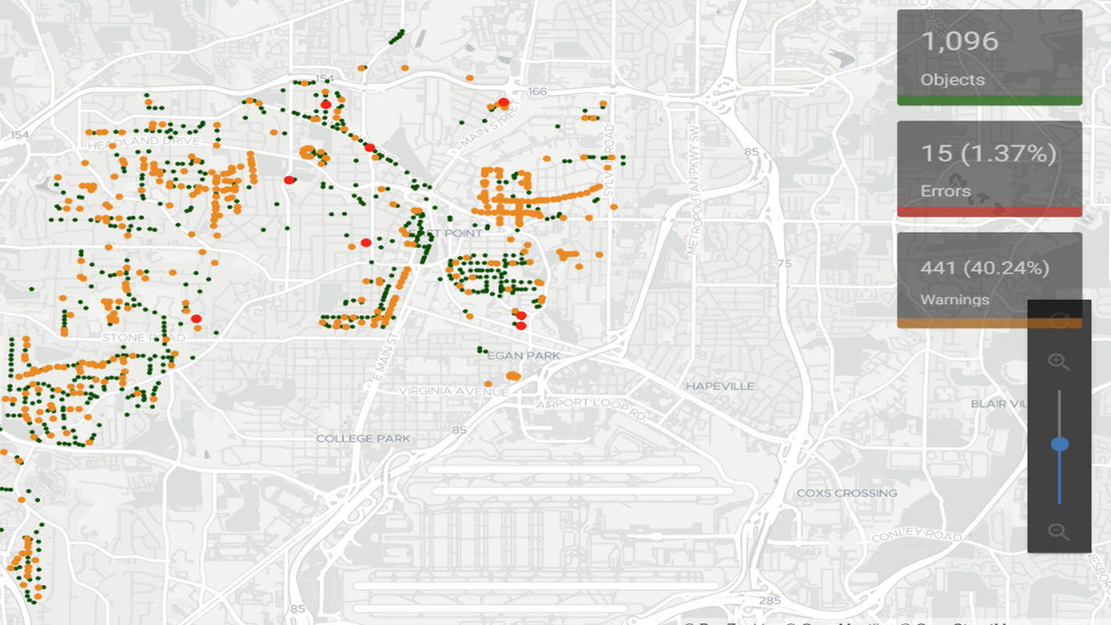
Street Light Dashboard
The City of East Point has invested over 2.2 million dollars on the street light project. This involved LED streetlight installations as well as more advanced controls for dimming the lights.

Slide 14
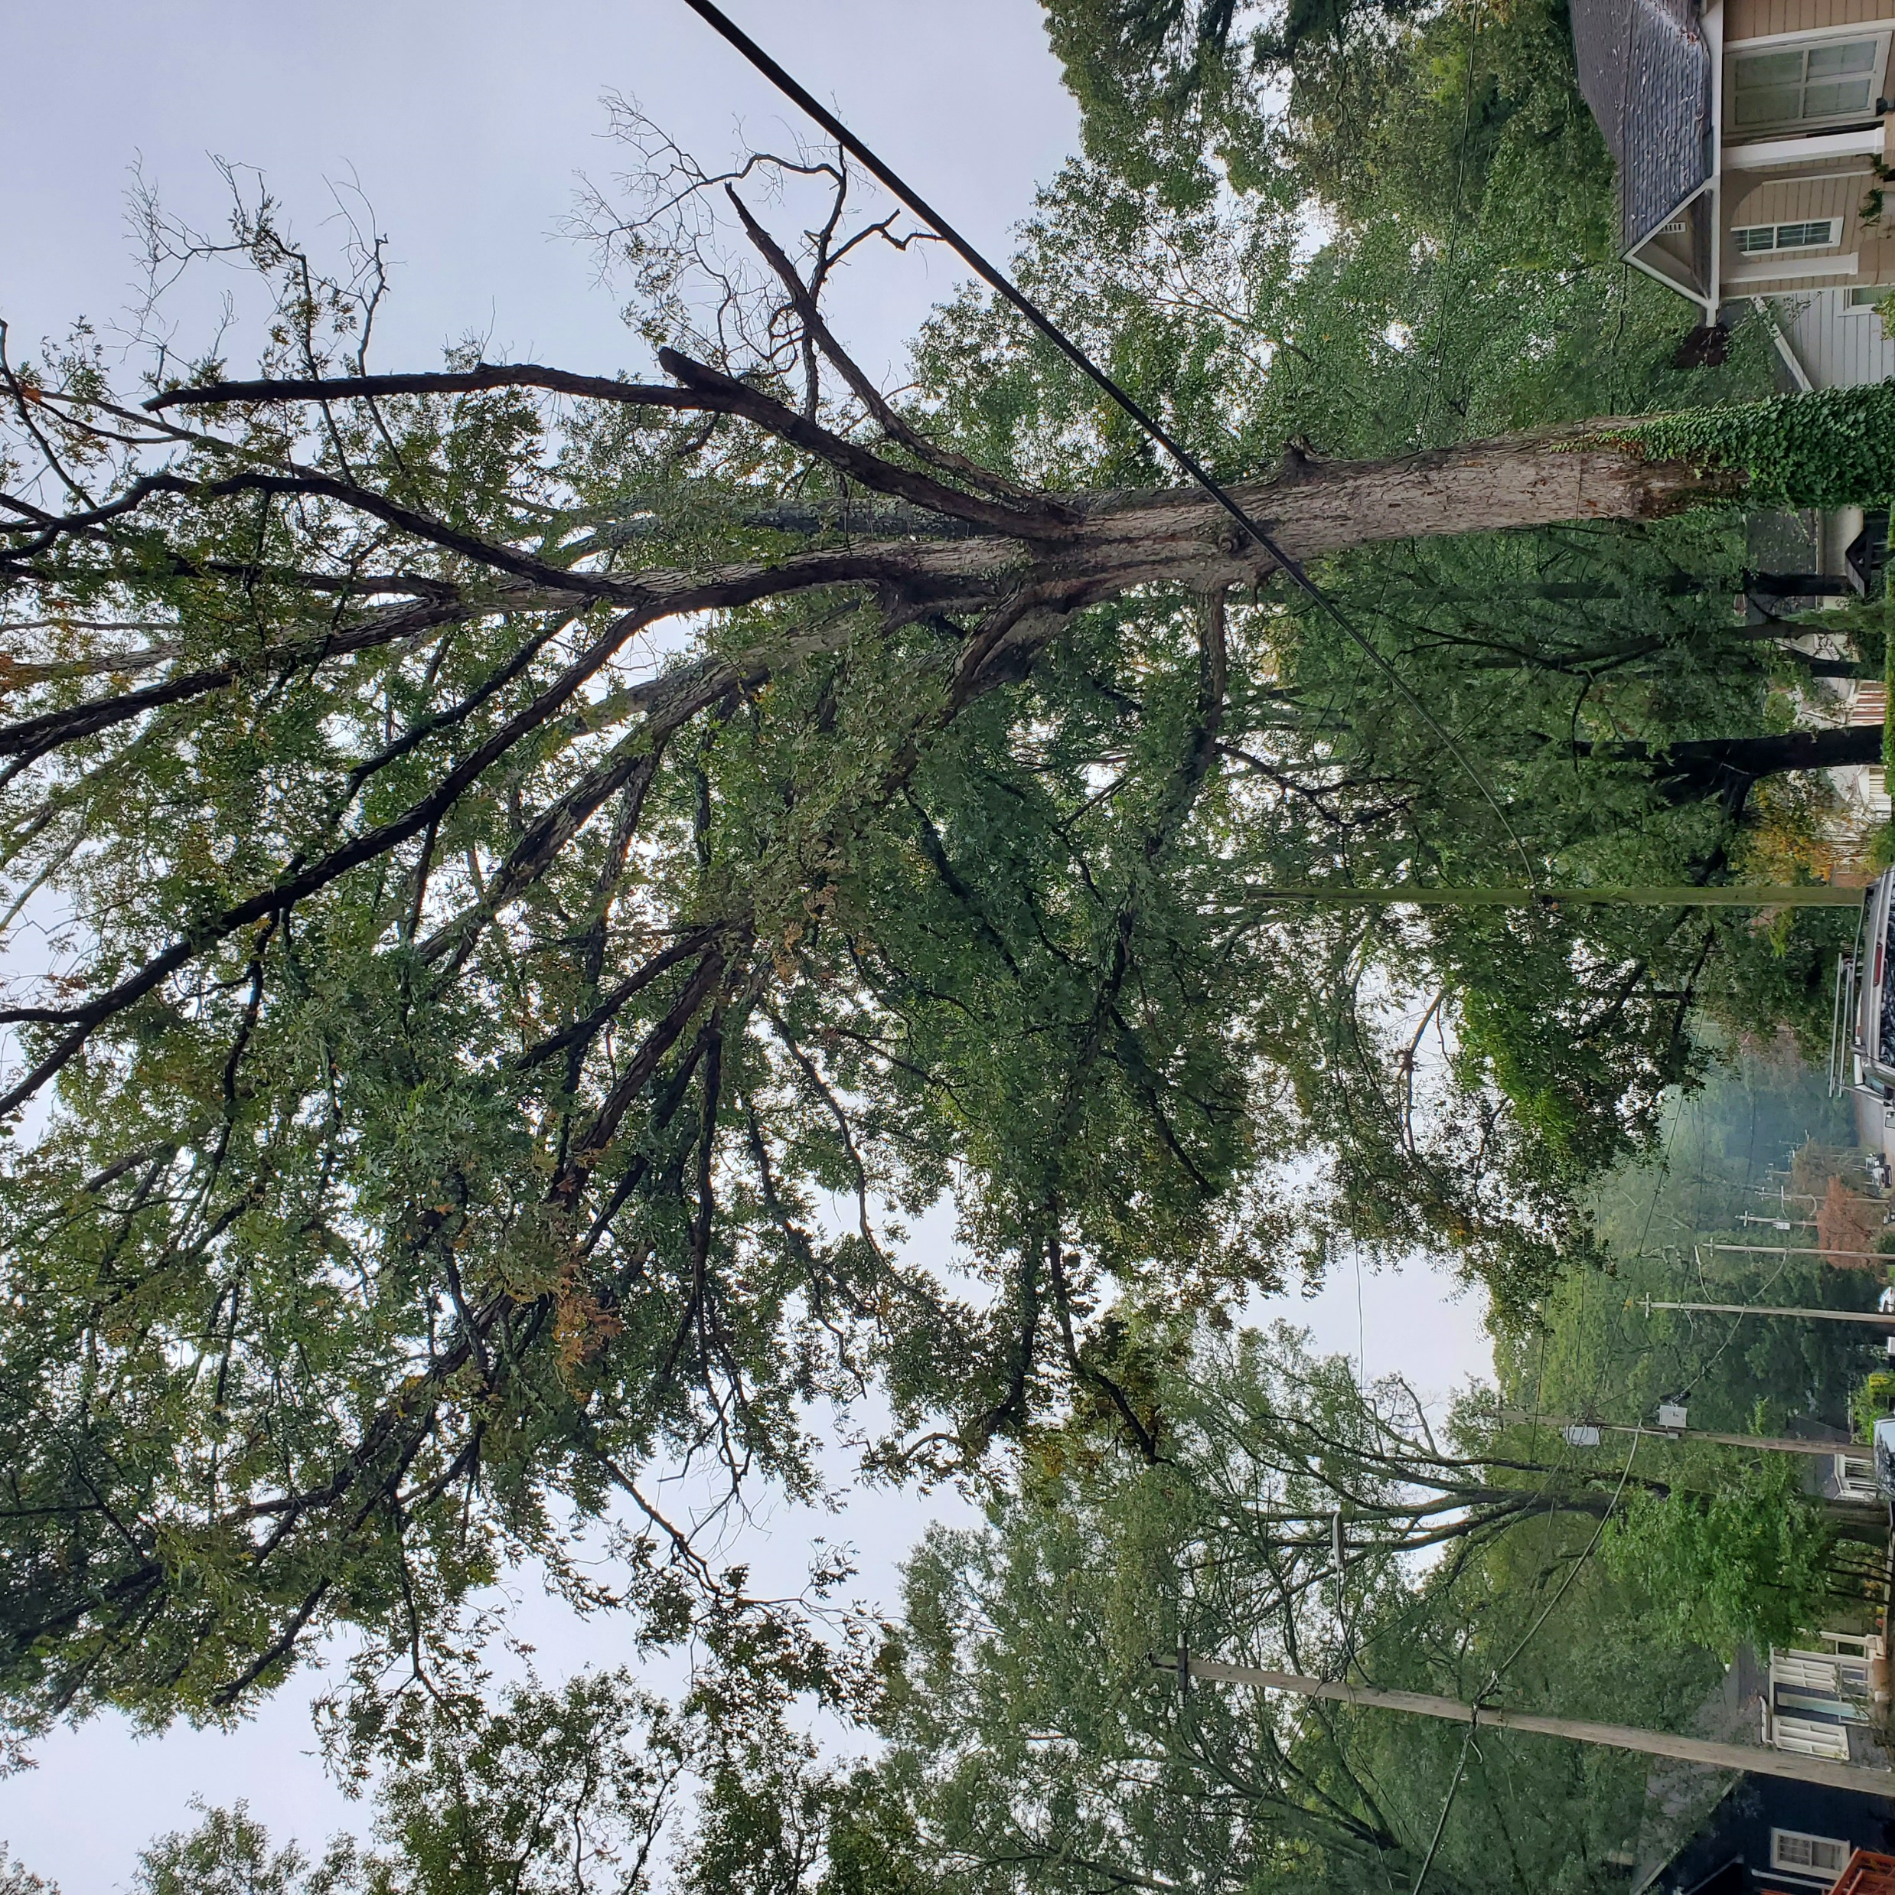
City of East Point-Trees

Slide 15
East Point Power Equipment List

Slide 16

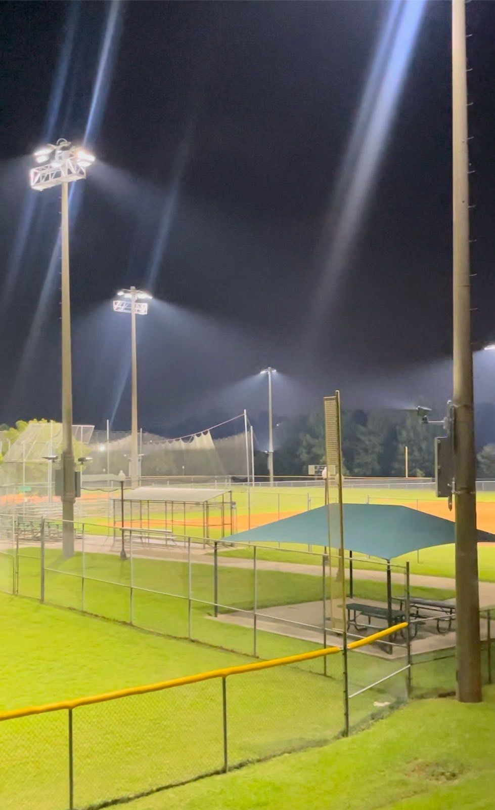
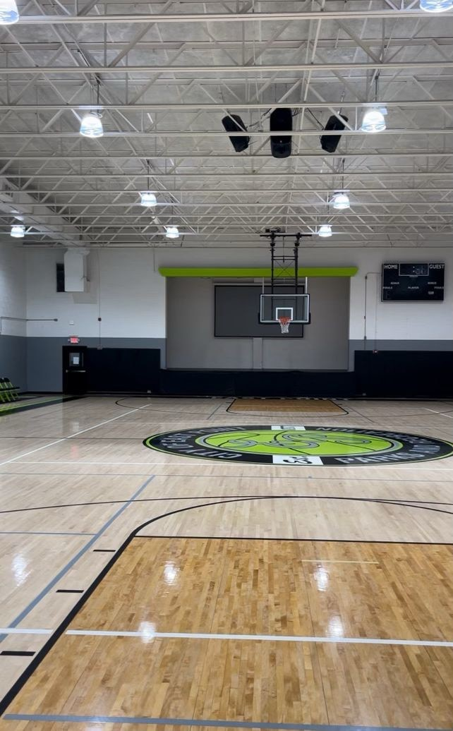
Special Lighting Projects
-Jefferson Park Rec Center
-John D. Milner Athletic Complex
-Sykes Park Tennis Complex

Slide 17
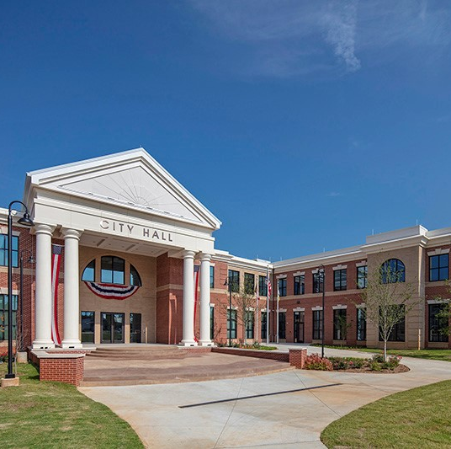
How to Report a Power Outage
Email: poweroutage@eastpointcity.org
404.270.7010

